Slide 1
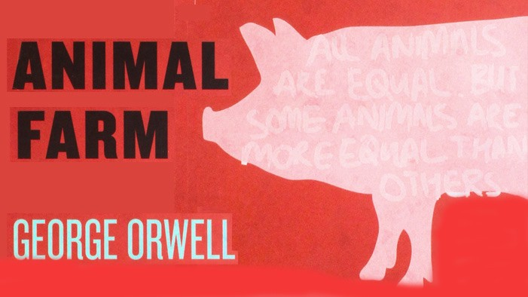
Monday, 18 March 2019
SWBAT…
Evaluate student writing by identifying errors in AF writing samples.
WARM-UP
Arable (adj.)
Malignity (n.)
Toil (v.)
Indignation (n.)
Solicitor (n.)
Intermediary (n.)
AGENDA
Intro prompt for timed write
Extended Schaffer quick review
AF Essay Peer Review
Finish Notebook Check #4 & Ch. 3 Annotations (if time)
DUE DATES
Today: AF Propaganda Poster
T, 19Mar2019: AF Ch. 4-5 Annotations (DOK 1-3)
R, 21Mar2019: AF Ch. 6 Annotations (DOK 1-3)

Slide 2
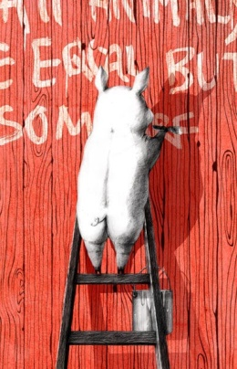
Animal Farm Ch. 6 Vocabulary
Arable (adj.) – fit for cultivation (farming)
Malignity (n.) – great hatred
Toil (v.) – work hard
Indignation (n.) – a feeling or expression of anger because of an unjust action
Solicitor (n.) – England, a lawyer
Intermediary (n.) – the person who acts as the go-between

Slide 3
Animal Farm: Ch. 6 Annotations
DOK 1 elements of the story
Character development and motivations for their actions
Predictions about how an event will impact the story
DOK 2 elements of the story
Types of propaganda
DOK 3
Allegory
Connections to relevant history and current events

Slide 4
Tuesday, 19 March 2019
SWBAT…
Identify the subject and predicate in an independent clause; and write a compound sentence using a coordinating conjunction.
WARM-UP
Would you wear the same clothes at the prom as you do at home? Explain. (3 sent.)
AGENDA
Compound Sentence Worksheet
Benchmark AF Paragraph
Finish Notebook Check #4 & Ch. 3 Annotations
DUE DATES
Today: AF Ch. 4-5 Annotations (DOK 1-3)
R, 21Mar2019: AF Ch. 6 Annotations (DOK 1-3)

Slide 5
Editing Focus: Sentence Combination
… has a noun (subject) and a verb (predicate), also called an independent clause.
combines… independent clauses… coordinating…
F or
A nd
N or
B ut
O r
Y et
S o

Slide 6
Editing Focus: Sentence Combination
Creating a compound sentence:
Complete sentence , complete sentence.

Slide 7
Wednesday, 20 March 2019
SWBAT…
Cite in-text sources of Animal Farm using Modern Language Association format
WARM-UP
Combine the following sentences using coordinating conjunctions (FANBOYS)
Boxer always listens to Napoleon.
Boxer is a hard worker.
AGENDA
Intro quotations and citations
AF Quote Research
DUE DATES
R, 21Mar2019: AF Ch. 6 Annotations (DOK 1-3)

Slide 8
MLA: Citing a Direct Quote

Slide 9
MLA: In-Text Citations
The in-text citation should properly attribute any ideas, paraphrases, or direct quotations to your source, and should direct readers to the entry in the list of works cited. For the most part, an in-text citation is the author’s name and the page number (or just the page number, if the author is named in the sentence) in parentheses:
Imperialism is “the practice, the theory, and the attitudes of a dominating metropolitan center ruling a distant territory” (Said 9).
According to Edward W. Said, imperialism is defined by “the practice, the theory, and the attitudes of a dominating metropolitan center ruling a distant territory” (9).

Slide 10
Thursday, 21 March 2019
SWBAT…
Construct a well organized and coherent paragraph about the propaganda used in Animal Farm.
WARM-UP
Be prepared to have your annotations and Notebook checked at some point during the timed write.
AGENDA
AF Timed Write
DUE DATES
Today: AF Ch. 6 Annotations (DOK 1-3)

Slide 11
Friday, 22 March 2019
SWBAT…
Accurately and precisely evaluate student writing samples from the timed write.
WARM-UP (P. 3 Only)
What do you plan on doing over Spring Break? (5 sent.)
WARM-UP
Write NDP on AF Timed Write and wait quietly for instructions
AGENDA
AF Timed Write Guided Peer Review
DUE DATES
None
Notes:
Instructions:
Write the number on the paper in the space provided next to “Paragraph Author’s name”.
Write your name, date, period in the space provided next to “Revisor’s name”.
You will be graded on how thoroughly you evaluate the student’s work.

