Slide 1
Video & Web Links
Pink Floyd, “Money” (4 minutes)
  https://www.youtube.com/watch?v=-0kcet4aPpQ
140 Years Of Monetary History In 10 Minutes (10 min)
  https://www.youtube.com/watch?v=wD3KYlpE2lk
Tally Sticks
  https://www.youtube.com/watch?v=ZGDh_JiZp9U
“The International” (2:20 minutes)
  http://www.youtube.com/watch?v=h_ZpXyrFSds
US and World Debt Clocks
  http://www.usdebtclock.org/
  http://www.usdebtclock.org/world-debt-clock.html

Slide 2
The Alchemy of Money
Money Creation, Central Banking, and Exorbitant Privilege
Notes:
Pink Floyd’s “Money”
https://www.youtube.com/watch?v=-0kcet4aPpQ

Slide 3
Agenda
Money
  What is it?
  How is it created?
  Who controls it?
Central Banking
  What is it?
  What is the Federal Reserve?
  What is fractional reserve lending?
Exorbitant Privilege
  What is a world reserve currency?
  What is the Triffin Dilemma?

Slide 4
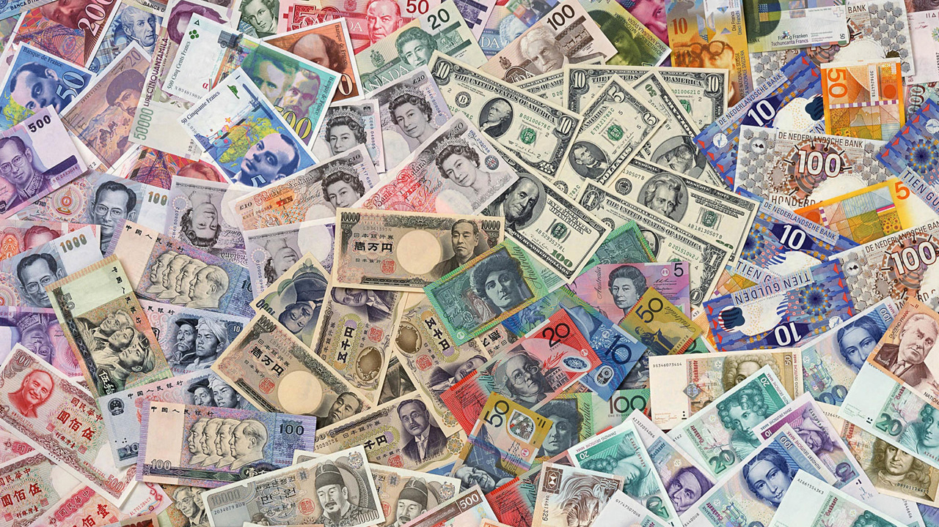
Money
When you think of money, what are some things that come to mind?
Notes:
Notes:
https://fskrealityguide.blogspot.com/2008/10/tally-stick-monetary-system.html (about the tally stick system)
https://unusualhistoricals.blogspot.com/2010/10/money-matter-tally-stick-system.html (about the tally stick system)

Slide 5
Thoughts on Money
“All the perplexities, confusion and distress in America arise, not from defects in their Constitution or Confederation, not from want of honor or virtue, so much as from the downright ignorance of the nature of coin, credit and circulation.” ~John Adams 2nd President of the United States
“He who controls the money supply of a nation controls the nation.” ~James A. Garfield 20th President of the United States

Slide 6
Thoughts on Money
“It is well enough that people of the nation do not understand our banking and monetary system, for if they did, I believe there would be a revolution before tomorrow morning. ~Henry Ford
“The real truth of the matter is, and you and I know, that a financial element in the large centers has owned the government of the U.S. since the days of Andrew Jackson.” ~Franklin D. Roosevelt in a letter to Edward M. House (President Wilson’s closest aide), November 23, 1933

Slide 7
Functions of Money
WRITE THIS DOWN IN YOUR GLOSSARY
Store of Value
  An asset that retains its purchasing power
Unit of Account
  A consistent standard of value to exchange goods and services
Medium of Exchange
  Convenient tradeable unit used to avoid the trading of commodities, e.g., cotton, bushels of hay, cows

Slide 8
Characteristics of Money
Divisible: Can it be broken down into smaller parts?
Portable: Can it be easily transported?
Acceptable: Is it widely accepted?
Scarce: Is it rare enough to be valuable?
Durable: Can it survive regular use without damage?
Stable: Does its value remain relatively constant over long periods of time?
WRITE THIS DOWN IN YOUR GLOSSARY

Slide 9
Types of Money
Commodity Money
  Have value even if it were not being used as money (intrinsic value), e.g. gold, silver, seeds, cows, et cetera
Commodity-Backed Money (Currency)
  Money that can be exchanged on demand for a specific commodity, e.g., gold standard, silver standard
Fiat Money (Currency)
  No intrinsic value but has value as money because of government decree, e.g., paying taxes
Notes:
Notes:
https://www.thoughtco.com/types-of-money-in-economics-1147762 (types of money)

Slide 10
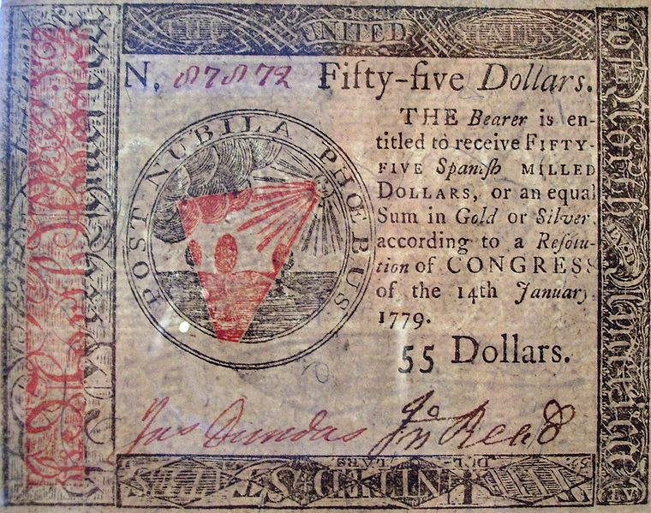
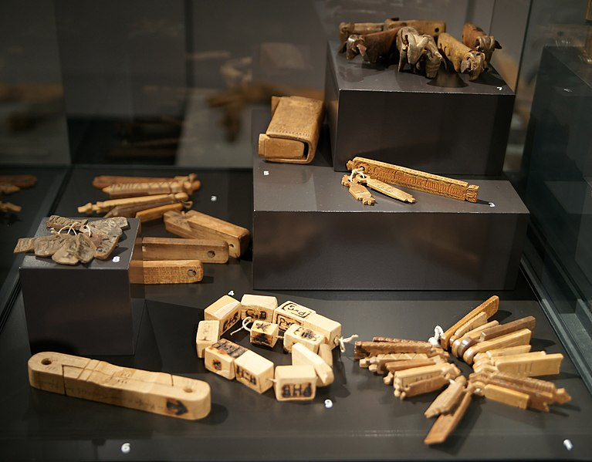
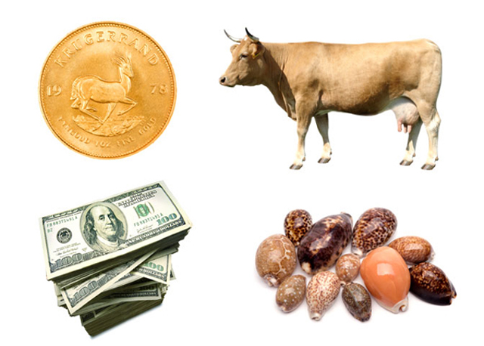
Forms of Money
What kinds of money do you see?
What functions and characteristics do they have?
Notes:
TALLY STICK (3 minutes):
https://www.youtube.com/watch?v=ZGDh_JiZp9U
Notes:
https://en.wikipedia.org/wiki/Tally_stick
https://en.wikipedia.org/wiki/History_of_money

Slide 11
Commodity-Backed vs. Fiat Money (Currency)
WHICH FORM IS MOST COMMONLY USED TODAY?
(IN THE DEVELOPED WORLD)

Slide 12
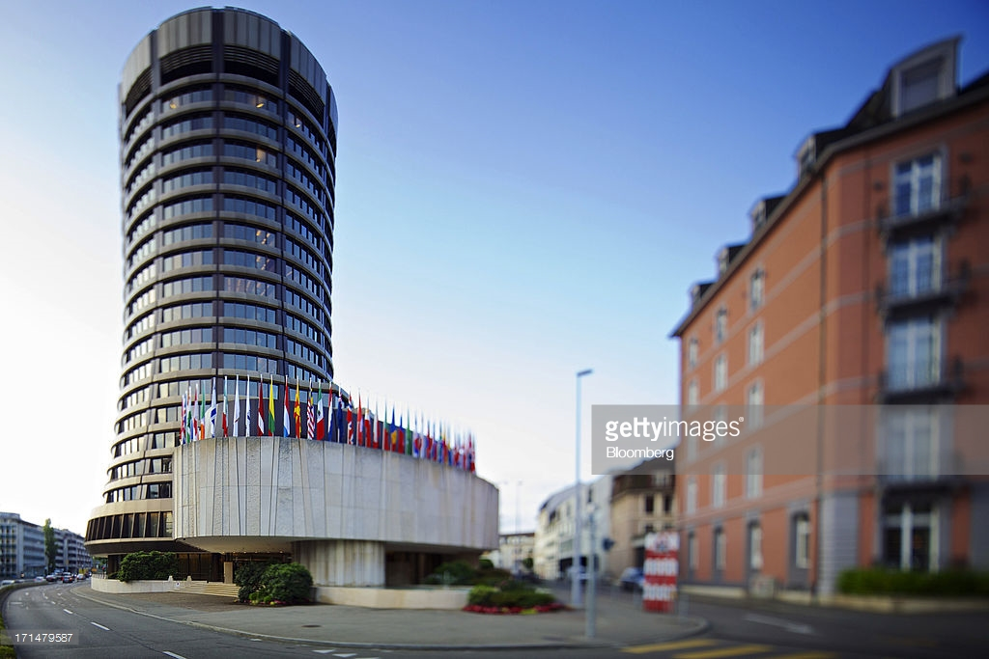
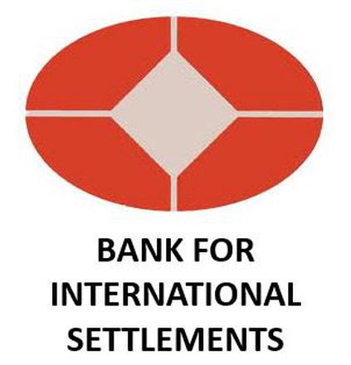
Central Banking
A brief history of fractional reserve lending

Slide 13
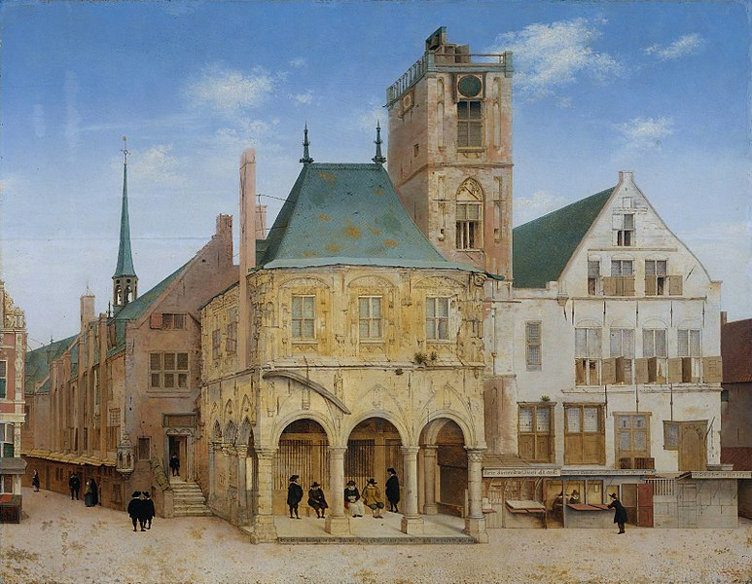
Bank of Amsterdam: Amsterdam Wisselbank (1609)

Slide 14
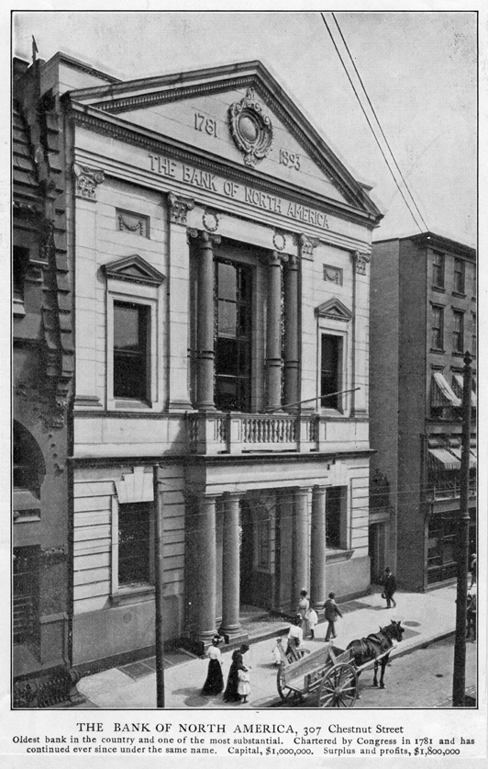
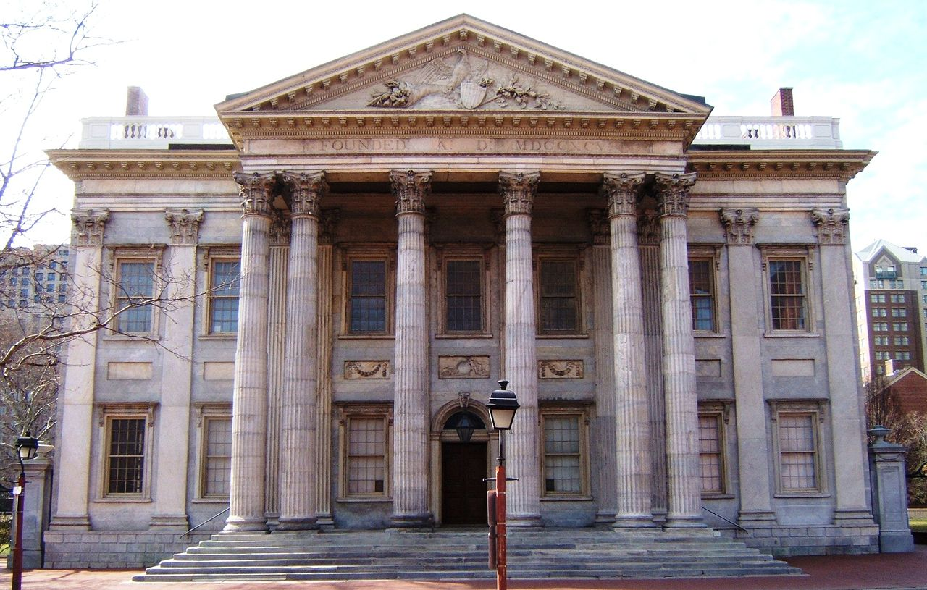
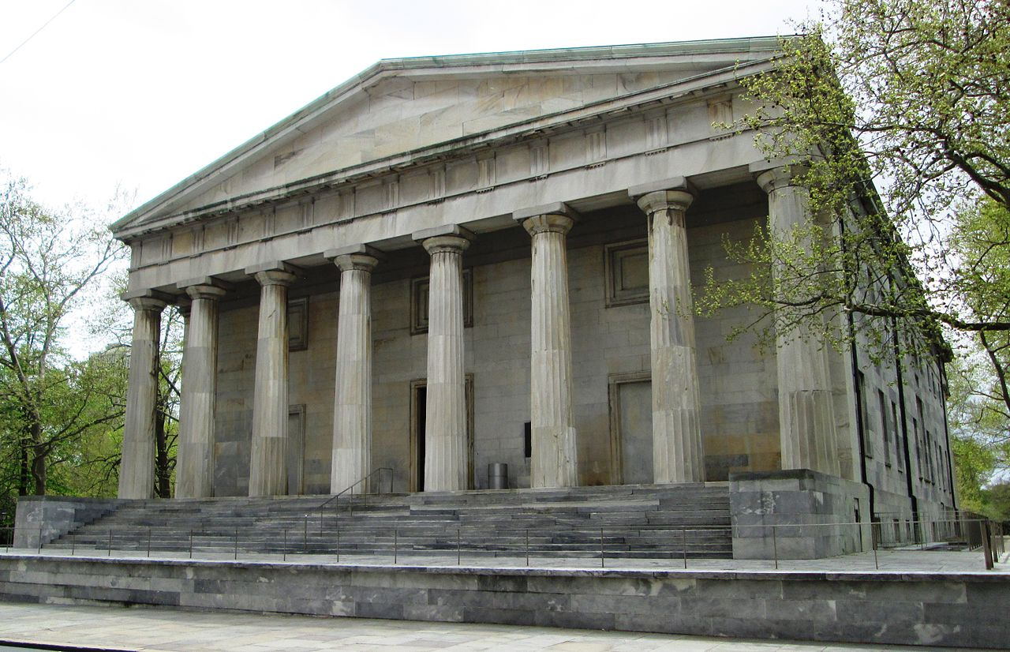
US Banking History
1781–1836
  The Bank of North America
  First Bank of the United States
  Second Bank of the United States
Notes:
1835: US federal government was debt free
In 1832, [Andrew] Jackson had vetoed a bill calling for an early renewal of the Second Bank’s charter, but renewal was still possible when the charter expired in 1836; to prevent that from happening, he set out to reduce the bank’s economic power. Acting against the advice of congressional committees and over the opposition of several cabinet members, and after replacing two resistant secretaries of the treasury with a more amenable appointee (Roger Taney), Jackson announced that, effective October 1, 1833, federal funds would no longer be deposited in the Bank of the United States. Instead, he began placing them in various state banks; by the end of 1833, twenty-three ‘pet banks’ (as they were popularly known) had been selected.
https://www.history.com/topics/bank-war

Slide 15
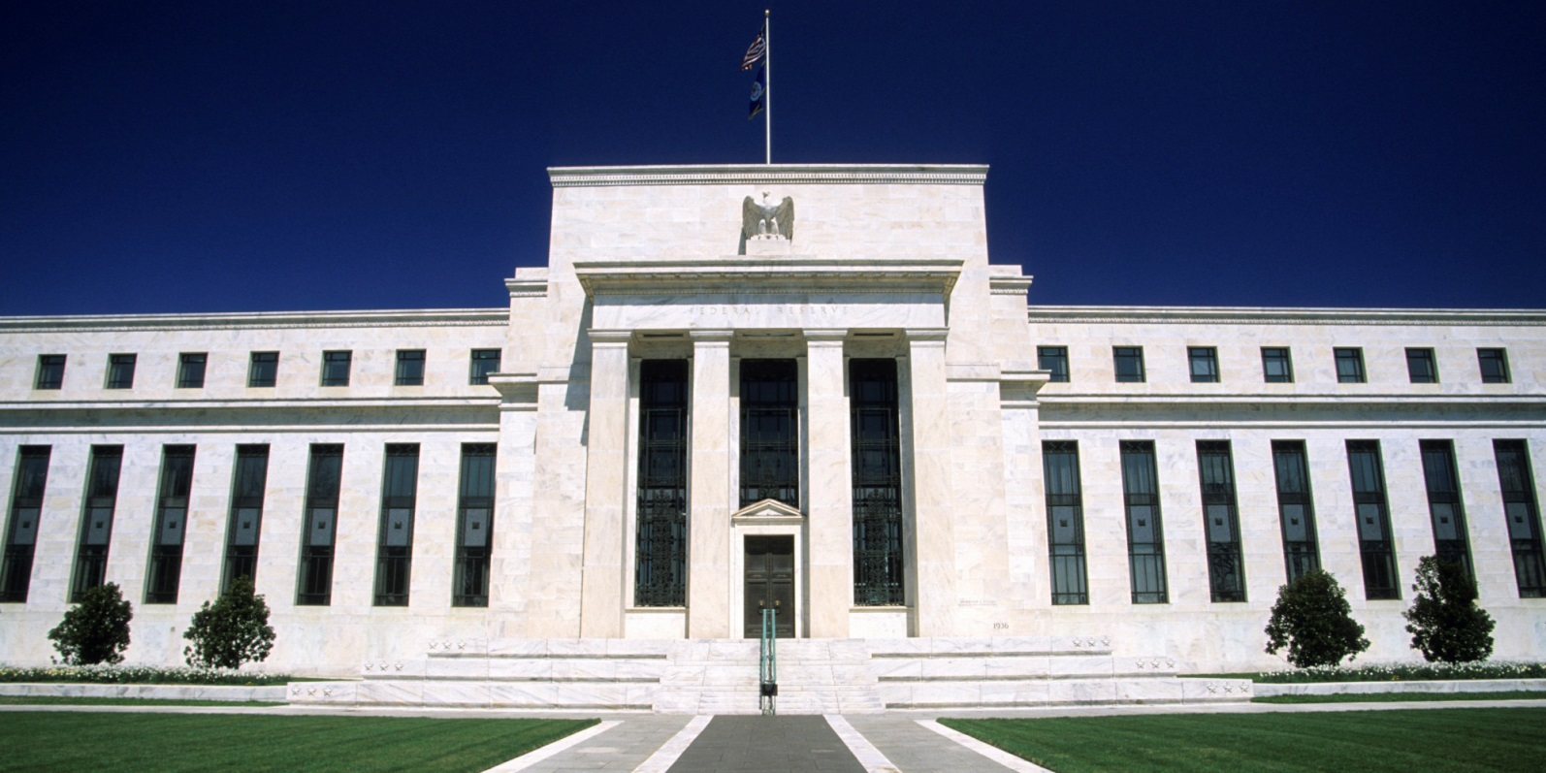
US Banking History
1913–Present
  The Federal Reserve System (The Fed)

Slide 16
Corporate & Private Fiat Currency
Since 1913
Not Federal
Has No Reserves
Private Bank

Slide 17
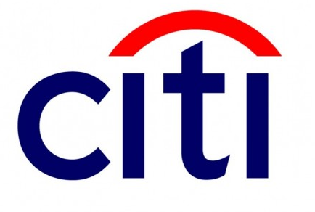
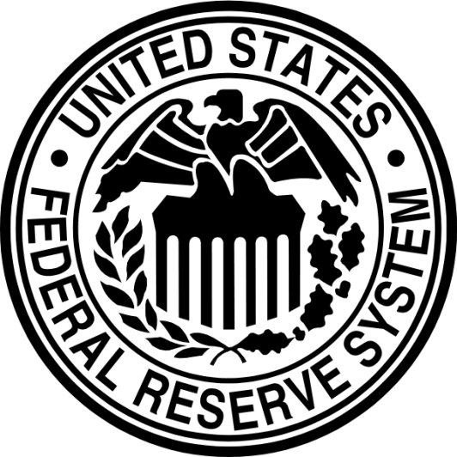




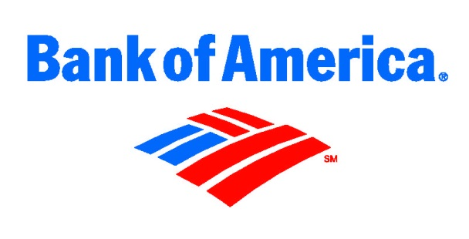
Fractional Reserve Lending
$1 = -$10
MONEY = DEBT = CREDIT
Notes:
Demonstrate how money creation takes place

Slide 18
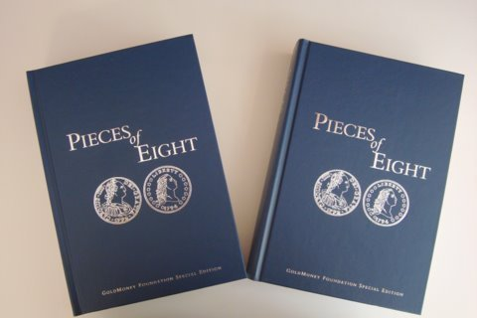
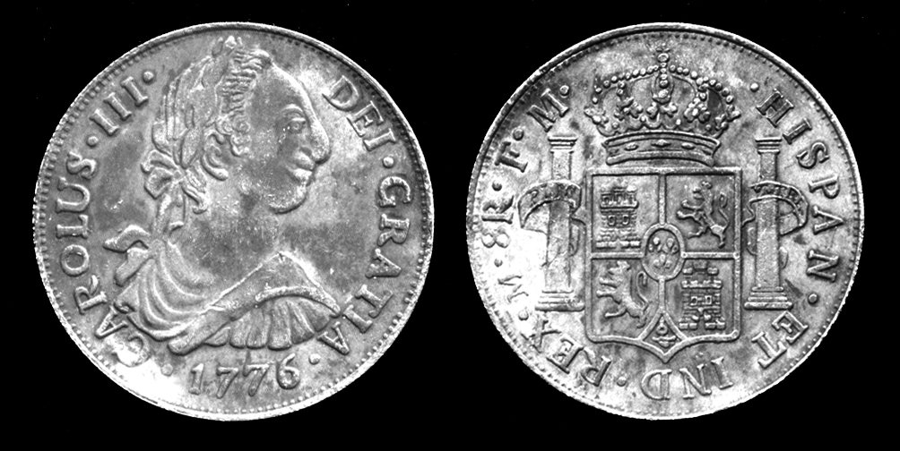
Constitutional Money
US Constitution: Article 1, Section 8
  “The Congress shall have power… To coin Money, regulate the Value thereof, and of foreign Coin, and fix the Standard of Weights and Measures; …”
US Coinage Act of 1792
  "the money of account of the United States shall be expressed in dollars or units … of the value of a Spanish milled dollar as the same is now current, and to contain three hundred and seventy-one grains and four sixteenth parts of a grain of pure … silver.
371.25 grains of silver = 0.8485714 ounce
Piece of Eight – Real De a Ocho
Notes:
Notes:
https://mises.org/library/constitutional-dollar

Slide 19
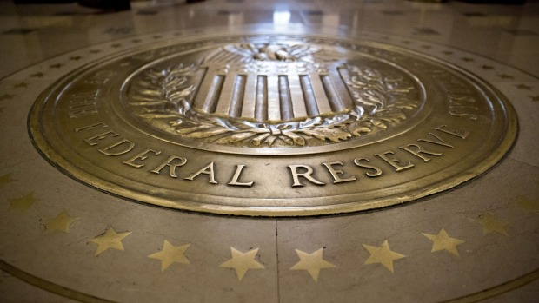
Exorbitant Privilege
World reserve status and the Triffin Dilemma
Notes:
140 Years Of Monetary History In 10 Minutes (10 min)
https://www.youtube.com/watch?v=wD3KYlpE2lk

Slide 20
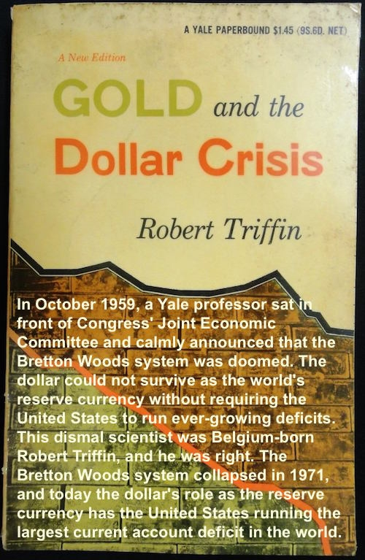
Triffin
Dilemma
Notes:
In economics, a country's current account is one of the three components of its balance of payments, the others being the capital account and the financial account. The current account consists of the balance of trade, net primary income or factor income and net cash transfers, that have taken place over a given period of time.
https://en.wikipedia.org/wiki/Current_account

Slide 21
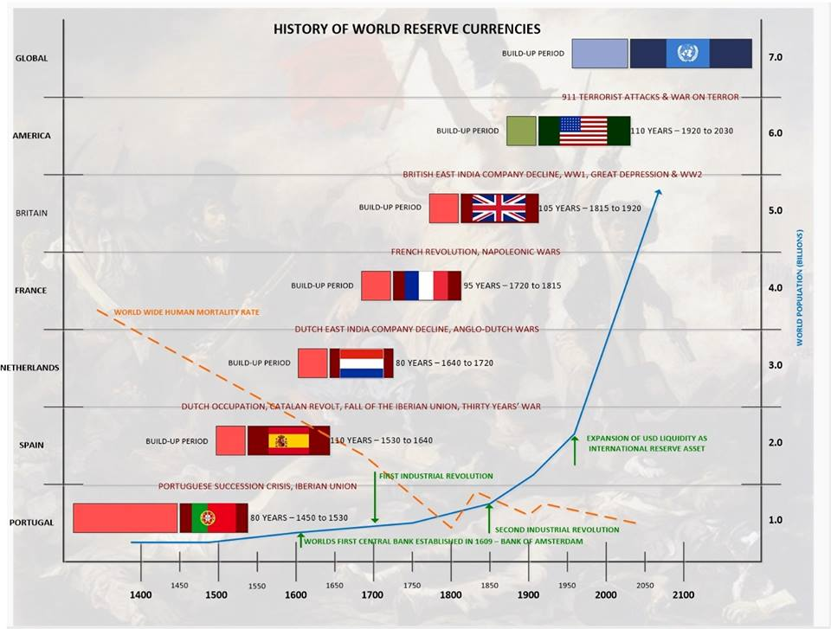
Notes:
http://www.usdebtclock.org/
http://www.usdebtclock.org/world-debt-clock.html

Slide 22
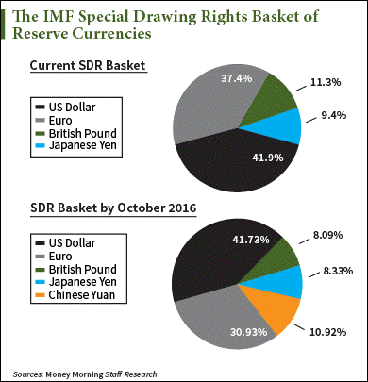
SDRs: The Next Global
Reserve Currency
Future X Factors:
> AI & Quantum computing > Blockchain & Crypto > Commodities boom
> Radical de-centralization

Slide 23
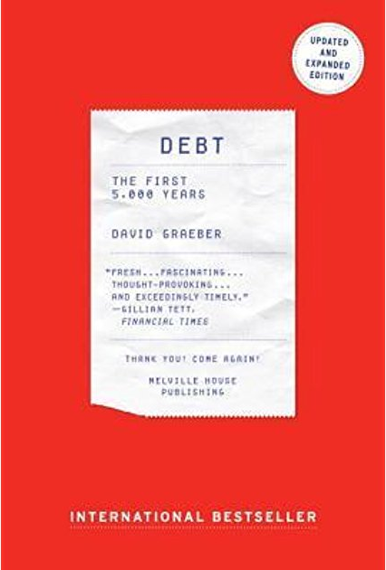
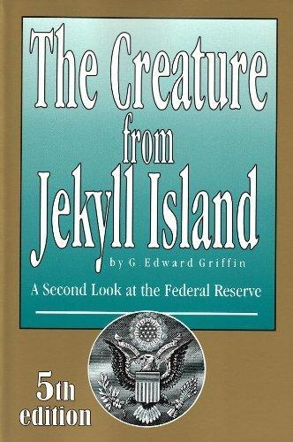
Recommended Reading
Notes:
PDF Copies
Debt: The First 5000 Years
https://docs.wixstatic.com/ugd/b8b6dc_e15b5964f1ab47889af4e289a705c5a8.pdf
The Creature From Jekyll Island
https://docs.wixstatic.com/ugd/b8b6dc_3835af3f7cf149e4ab362e2fa8509e25.pdf

Slide 24
Recommended Viewing
The Ascent of Money: A Financial History of The World by Niall Ferguson
  https://www.youtube.com/watch?v=fsrtB5lp60s
Money As Debt by Paul Grignon
  https://www.youtube.com/watch?v=2nBPN-MKefA&list=PLmpODdsfprYH4Fhsso8PVPQBNxVDQSgb_
The Money Masters by Bill Still
  https://www.youtube.com/watch?v=HBk5XV1ExoQ

Slide 25
Supplemental Slides

Slide 26
Money=Debt=Credit
2 Kinds of Money Creation
  Federal Reserve Notes (via Treasury Bonds)
    Money starts out as a bond, which is a debt
    Interest is charged to the government to create this dollar
  Banks (via Fractional Reserve Lending – 90% of money creation)
    Banks can lend $9 for every $1 they have
    This ratio of 1:10 is called a capital requirement/reserve ratio
Therefore, for every $1 that is created, $10 of debt is created

Slide 27
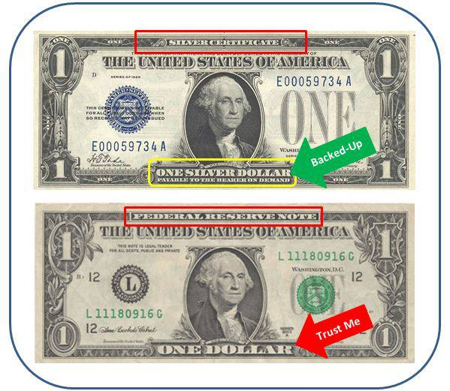


Money vs. Debt

Slide 28
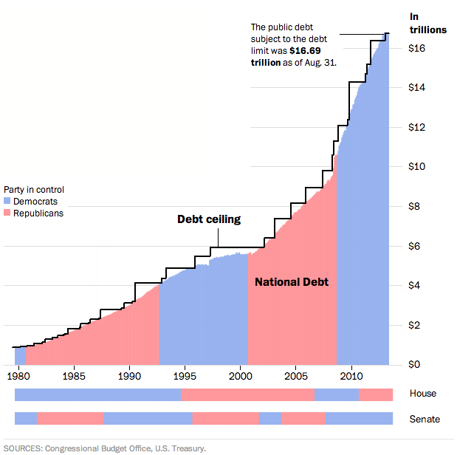
The Debt Consensus
Notes:
(2:20 clip: “The International” on how debt functions)
http://www.youtube.com/watch?v=h_ZpXyrFSds

Slide 29
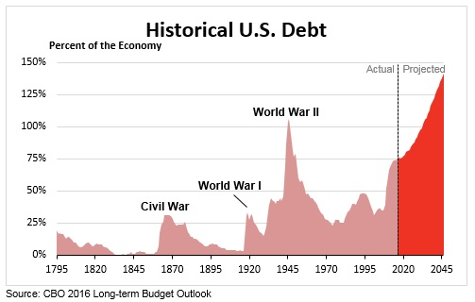
War Isn’t Cheap
Notes:
(2:20 clip: “The International” on how debt functions)
http://www.youtube.com/watch?v=h_ZpXyrFSds

