Slide 1
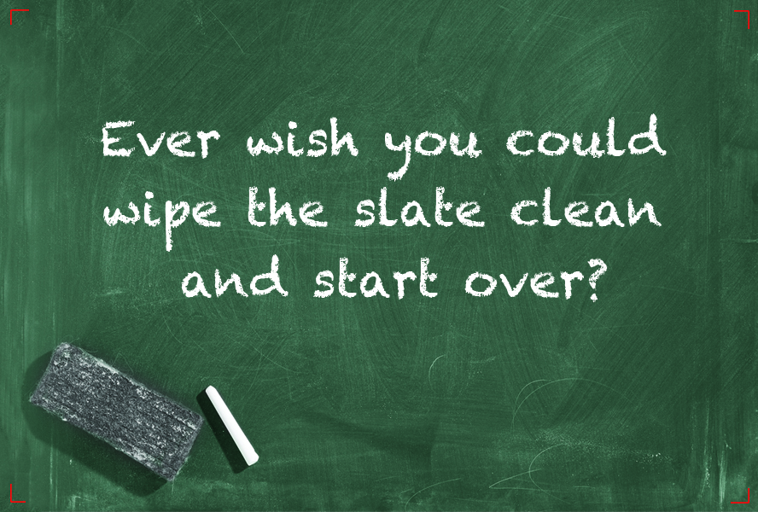

Slide 2
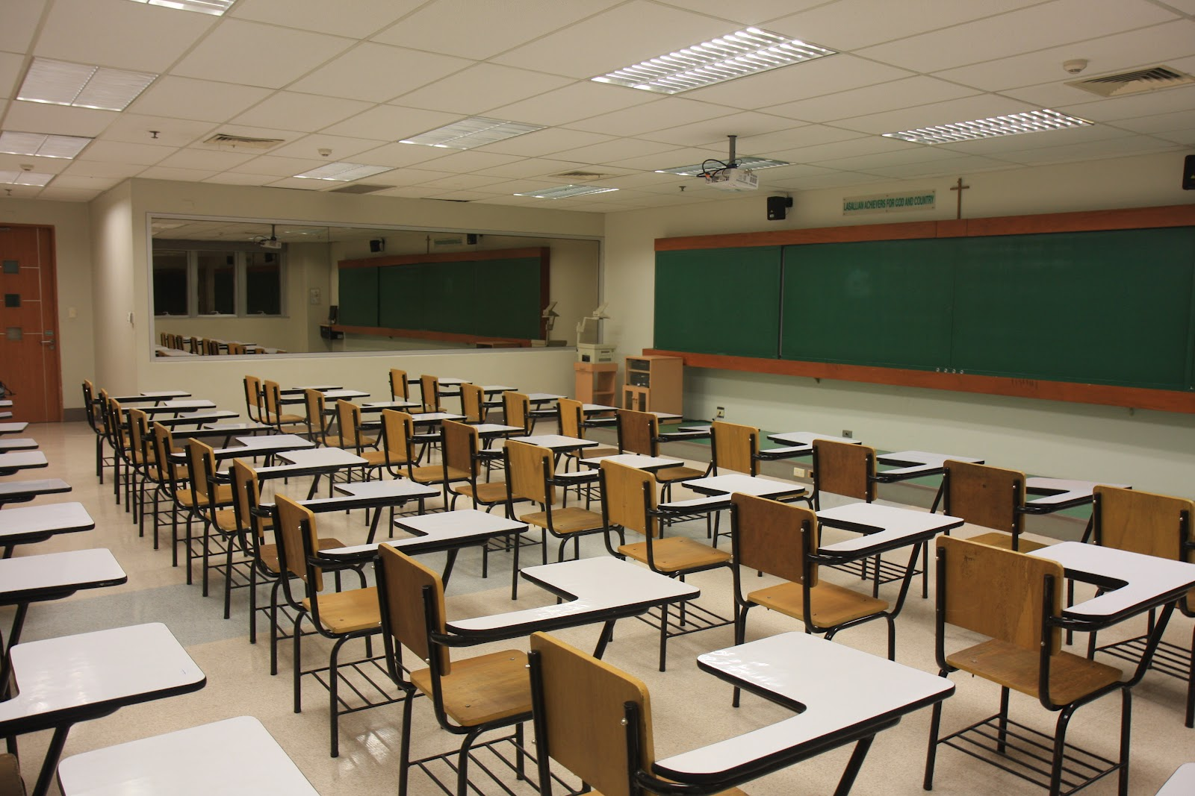
New Seating Chart
Please gather your things and listen for your name. You will be assigned a new seat.

Slide 3

Prepare To Take Notes Now
Please take out your notebook and pen/pencil and prepare to copy the information on the next few slides in your own words.

Slide 4
How to organize your Notebook
You will make entries in your Notebook each day.
Place your paper clip on the page of the most recent entry in your Notebook
Notebook checks happen weekly (during silent reading time), and are graded for completion

Slide 5
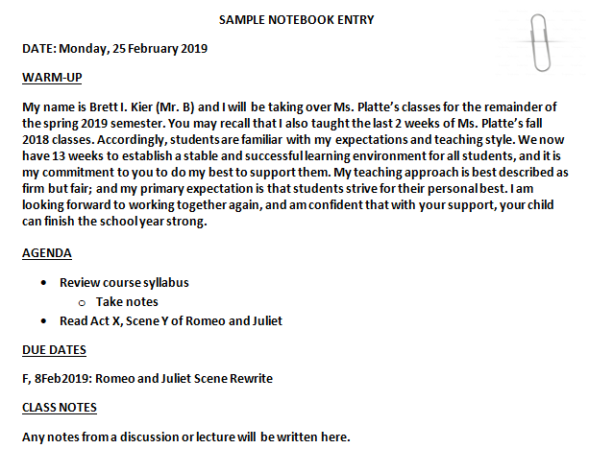

Slide 6


Monday, 25 February 2019
SWBAT…
Paraphrase, in writing, the new rules and expectations of the class.
DO NOW
Take out your notebook and a pencil and quietly wait for the sound of the bell (place your syllabus and paperclip on your desk).
WARM-UP
Who is the most important person in your life? Why? (5 sent.)
AGENDA
Introductions, Seating chart
Take notes on class syllabus
Review class expectations and website
Preview remainder of semester
Notebook Check
DUE DATES:
M, 25Feb2019: Notebook Check
T, 26Feb2019: Signed Syllabus
=

Slide 7
Course Syllabus and Class Expectations
Bathroom breaks 15 min. after the bell; and up until 15 min. before the end of class.
No food, electronics, hats/hoods, or sunglasses in class (water is ok).
All work turned in must have Name, Date, and Period in upper left corner (if not, work will receive a 5% penalty).
Class Participation: points are earned when you participate in discussion.

Slide 8
Course Syllabus and Class Expectations
When you hear the bell, listen carefully.
Everything in, on, or around Mr. B’s desks is never to be touched without permission.
Centaur Plus will be your best opportunity to get one-on-one feedback from me about any assignments.
The agenda slides will be posted on the class website within 48 hours of the class.

Slide 9
Course Syllabus and Class Expectations
The materials you need for the day will be on the trapezoidal table.
The agenda slides will be posted on the class website within 48 hours of the class.
Stay in your seat/keep working until the bell rings.
Mr. B, not the bell, will dismiss you when you are sitting quietly in your seat.

Slide 10
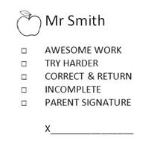





What does that stamp mean?
Follow the directions next to the check mark
Good Job!
Good Job!
Work turned in with no Name, Date, or Period (5% Penalty)
Worked turned in 1 day late (20% Penalty)
Worked turned in 1 day late after an excused absence (Full Credit)

Slide 11
Tuesday, 26 February 2019
SWBAT…
Create a storyboard that presents an alternative ending to Romeo and Juliet based on their understanding of Act 5, Scene 3 (lines 238-278).
DO NOW
Take out your notebook, copy the agenda, then put your Name, Date, and Period on the white printer paper. Title this blank paper “Romeo and Juliet 4 Panel Storyboard”
Take the book from under your desk and turn to page 1100.
WARM-UP
Describe a decision you made that if you could do over you would do differently? (5 sent.)
AGENDA
R&J: Read lines 238-78 of A.5, S.3
Begin 4 Panel Storyboard
DUE DATES:
> Today: Signed Syllabus
> W, 27Feb2019: R&J 4 Panel Storyboard

Slide 12
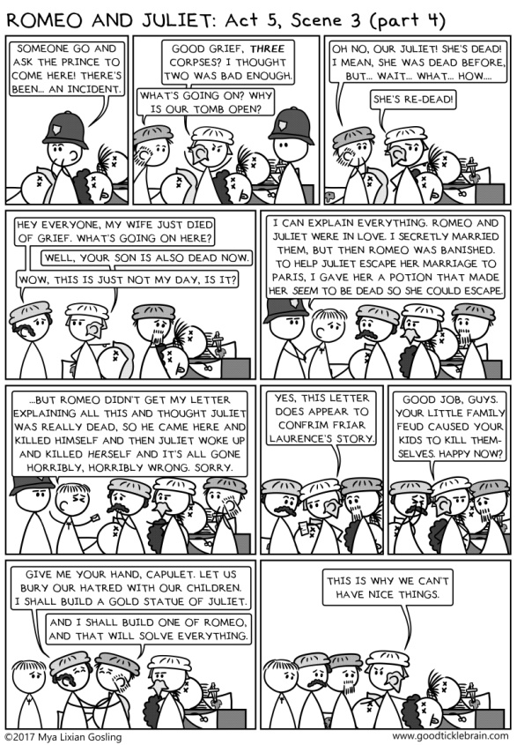
R & J: 4 Panel Storyboard
Requirements:
3 sentences of narration per panel (3rd person)
Dialogue in each panel
Color illustrations for each panel

Slide 13
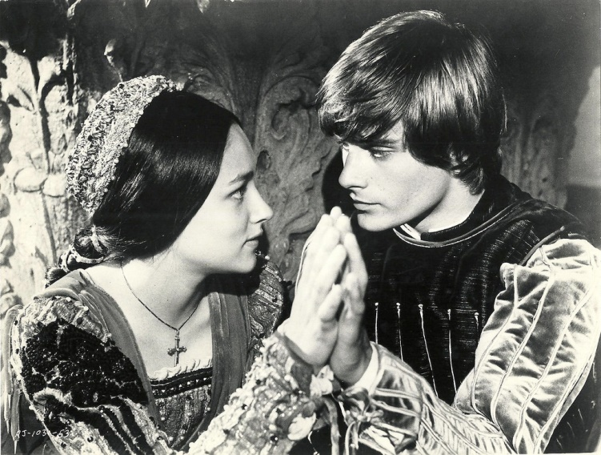
Wednesday, 27 February 2019
SWBAT…
Complete a storyboard that presents an alternative ending to Romeo and Juliet.
DO NOW
Copy the agenda and complete the Warm-Up.
WARM-UP
If you had to live your life as an animal, which one would you choose to represent your personality? Why? (5 sent.)
AGENDA
Complete your “Romeo and Juliet 4 Panel Storyboard”
DUE DATES:
> Today: R&J 4 Panel Storyboard

Slide 14
Thursday, 28 February 2019
SWBAT…
Read, annotate, identify textual evidence, and summarize text
DO NOW
Take out your notebook, complete the WARM-UP, and copy the AGENDA.
WARM-UP
1. All people are equal. TRUE/FALSE
2. Usually, the best and brightest people are leaders. TRUE/FALSE
3. Good citizens always follow the laws of their government. TRUE/FALSE
4. A dictator can be easily overthrown. TRUE/FALSE
5. The government usually does what is best for the most people. TRUE/FALSE
6. People should always believe what they’re told by authorities. TRUE/FALSE
7. Uneducated people are more easily controlled than educated people. TRUE/FALSE
8. People always have the ability to make their own choices. TRUE/FALSE
AGENDA
The Third Wave document analysis
DUE DATES
> F, 1Mar2019: Notebook Check

Slide 15
R & J Storyboard Rubric
POINTS PER PANEL
Dialogue – 1 point
Illustration – 1 point
Color – 1 point
Narration – 3 points (1 per sent.)
TOTAL POINTS PER PANEL: 6 Points
(6 points x 4 panels = 24 points)
Cool Factor – 1 point
TOTAL POINTS POSSIBLE: 24 + 1 = 25 points

Slide 16
Friday, 1 March 2019
SWBAT…
Summarize text using claims, reasons, evidence, and counter-claims/rebuttal.
WARM-UP
Copy the following sentences (skipping lines):
Esperanza should be elected class president because she is a natural leader. When we got lost in the Yosemite Mountains on our class trip, Esperanza took control and navigated us back to civilization. >>>
Although Talia is running for a second term, she has not kept her campaign promises.
AGENDA
Take notes: Claims, Reasons, Evidence, Counterclaims/Rebuttal
Complete The Third Wave document analysis
DUE DATES
Today: Notebook Check
M, 4Mar2019: The Third Wave doc analysis packet

Slide 17
Claims
A claim is your ARGUMENT. Claims are statements of belief that can be argued against.
Ex Gratia (e.g. – for example): Esperanza should be elected class president.

Slide 18
Reasons
A reason is your LOGICAL SUPPORT. Reasons are statements of logic that support your statement or belief, id est (i.e. – that is to say), your claim.
Ex Gratia (e.g. – for example): Esperanza should be elected class president because she is a natural leader.

Slide 19
Evidence
Evidence is your PROOF. Evidence comes from sources, fieldwork, and research.
Ex Gratia (e.g. – for example): Esperanza should be elected class president because she is a natural leader. When we got lost in the Yosemite Mountains on our class trip, Esperanza took control and navigated us back to civilization.

Slide 20
Counter-claim/Rebuttal
Counter-claim/Rebuttal describes other plausible claims with COUNTER EVIDENCE and reasoning.
Ex Gratia (e.g. – for example): Esperanza should be elected class president because she is a natural leader. When we got lost in the Yosemite Mountains on our class trip, Esperanza took control and navigated us back to civilization. Although Talia is running for a second term, she has not kept her campaign promises.

Slide 21
The Third Wave Doc Analysis
Question: Do you think an experiment like the one conducted at Cubberley High School would work at Culver City High School? Why or why not?
Answer: The Third Wave experiment could work at Culver City High School because , although it is 2019 and not 1967, teenagers today are not very different from those in the past, in terms of being influenced by peer pressure.

Slide 22
The Third Wave Doc Analysis
Question: Do you think an experiment like the one conducted at Cubberley High School would work at Culver City High School? Why or why not?
Answer: The Third Wave experiment could work (claim) at Culver City High School because, although it is 2019 and not 1967, teenagers today are not very different from those in the past, in terms of being influenced by peer pressure.

Slide 23
The Third Wave Doc Analysis
Question: Do you think an experiment like the one conducted at Cubberley High School would work at Culver City High School? Why or why not?
Answer: The Third Wave experiment could work (claim) at Culver City High School because (reason), although it is 2019 and not 1967, teenagers today are not very different from those in the past, in terms of being influenced by peer pressure.

Slide 24
The Third Wave Doc Analysis
Question: Do you think an experiment like the one conducted at Cubberley High School would work at Culver City High School? Why or why not?
Answer: The Third Wave experiment could work (claim) at Culver City High School because (reason), although (counter-claim) it is 2019 and not 1967, teenagers today are not very different from those in the past, in terms of being influenced by peer pressure.

Slide 25
The Third Wave Doc Analysis
Question: Do you think an experiment like the one conducted at Cubberley High School would work at Culver City High School? Why or why not?
Answer: The Third Wave experiment could work (claim) at Culver City High School because (reason), although (counter-claim) it is 2019 and not 1967, teenagers today are not very different from those in the past, in terms of being influenced by peer pressure (evidence).

Slide 26
The Third Wave Doc Analysis
Summarize how the third wave developed so quickly.
Discussion Questions: Write in complete sentences using claims, reasons, evidence, and counter-claims/rebuttals.
Answers must be in Third Person (he, she, it, they, them)
Notes:
Transition to Old Major’s Speech after students complete the above.
-----------------------------------------------------
Summarize how the third wave developed so quickly (practice transitional phrases)
Learned Helplessness activity to show speed of behavioral changes
Discussion questions: practice thesis writing/shaeffer para together (provide sentence frames for these)

Slide 27

Monday, 4 March 2019
SWBAT…
Identify Claims, Reasons, Evidence, and Counterclaims in Chapter 1 of Animal Farm.
WARM-UP
If you had to convince your colleagues in the classroom to take over the school, how would you do it? (5 sent.)
AGENDA
Pick up Animal Farm at library
George Orwell Notes
Begin Chapter 1: Animal Farm
DUE DATES
Today: The Third Wave Packet

Slide 28
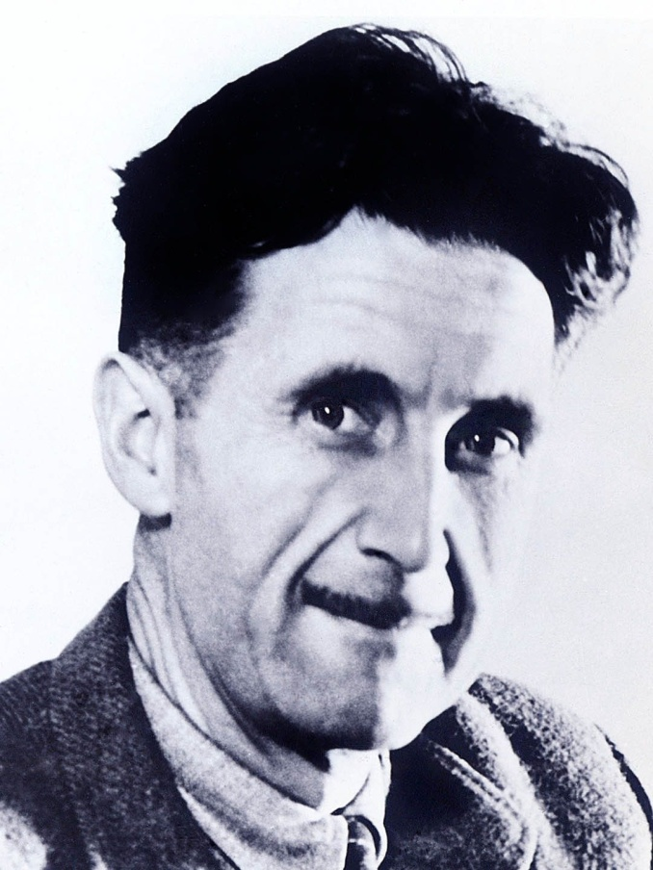
George Orwell Notes
Watch video (link below)
Write 1 fact for each of the 5 Ws:
Who?...
What?...
Where?...
When?...
Why?...
https://www.youtube.com/watch?v=kvXU3vzHq8E

Slide 29
The Third Wave Rubric
Annotations – 10 points
All underlined words are accompanied by comments
Multiple Choice – 2 points each (8 points)
Summary – 10 points
Describe process of change over time through the use of transitional phrases (next, after, then); and cause and effect (because x, then y)
Discussion Questions – 10 points each (30 points)
Claim – 2 points
Reason – 2 points
Evidence – 2 points
Grammar, Syntax, and Spelling – 2 points
Third person – 2 points
TOTAL: 58 POINTS

Slide 30
Tuesday, 5 March 2019
SWBAT…
Identify Claims, Reasons, and Evidence in Chapter 1 of A.F.
WARM-UP
Copy the following vocab words:
Cynical (adj)
Dissentient (adj)
Enmity (n)
Ensconce (v)
Plaited (adj)
Benevolent (adj)
Abolish (v)
AGENDA
AF Annotation Notes
Read AF Ch. 1
Annotate AF Ch. 1
DUE DATES
R, 7Mar2019 Animal Farm Ch. 1 Annotations

Slide 31
Animal Farm Ch. 1 Vocabulary
Cynical (adj) – tending to disbelieve
Dissentient (adj) – disagreeing; describing a person who disagrees
Enmity (n) – mutual hatred or hostility, ill will
Ensconce (v) – settle comfortably
Plaited (adj) – braided
Benevolent (adj) – kind
Abolish (v) – to get rid of

Slide 32
Animal Farm Annotation Notes
DOK 1
Character development and motivations
Predictions about how an event will impact the story
DOK 2
Types of propaganda
DOK 3
Allegory
Connections to relevant history and current events
DOK 4
Author’s purpose

Slide 33
Animal Farm: Ch. 1 Annotations
Annotate Ch. 1 of Animal Farm, identifying the following in Old Major's Speech:
Claims
Reasons
Evidence
5 Vocabulary Words with their definitions

Slide 34
Wednesday, 6 March 2019
SWBAT…
Identify literal vs. figurative character descriptions in AF
WARM-UP
Write down the best part of your day so far; then write your name, date , and period on the Animal Gallery Walk handout
AGENDA
AF Gallery Walk
Debrief
DUE DATES
R, 7Mar2019: AF Gallery Walk worksheet
R, 7Mar2019: Animal Farm Ch. 1 Annotations

Slide 35
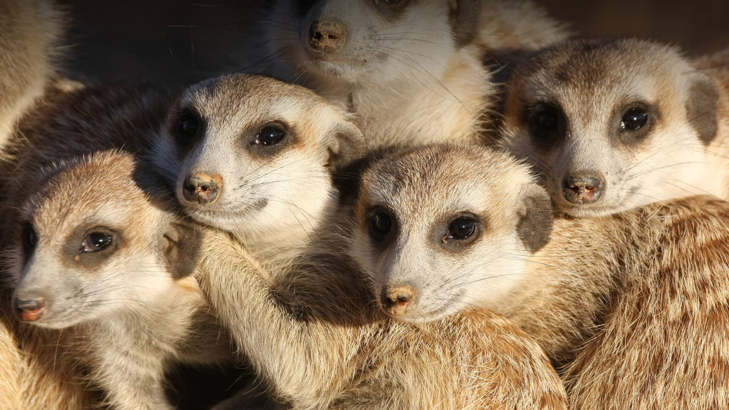
Animal Farm Gallery Walk
Literal Descriptions
Figurative Descriptions
Sand-colored hair
Long whiskers
Dark eyes
4 Legged
Rodent
“Hakuna matata!” (Timon)
Desert ninjas
Lookouts

Slide 36
Animal Farm Gallery Walk
Instructions:
Fill out the “Literal” and Figurative” features for each animal
3 minutes per station
Stay in your groups of 3 or 4

Slide 37
Thursday, 7 March 2019
SWBAT…
Identify DOK 1 evidence in Ch. 2 of AF, after understanding the vocabulary words for Ch. 2
WARM-UP
Copy the following words:
Apathy (n.)
Gambol (v.)
Preeminent (adj.)
Tormentors (n.)
AGENDA
Debrief Galley Walk
AF Ch. 2 Vocabulary
Read AF Ch. 2
Annotate AF Ch. 2 (DOK 1)
Check AF Ch. 1 Annotations
DUE DATES
Today: AF Gallery Walk handout
Today: AF Ch. 1 Annotations
T, 12Mar2019: AF Ch. 2 Annotations

Slide 38
Animal Farm Ch. 2 Vocabulary
Apathy (n.) – a lack of emotion
Gambol (v.) – frolic, skip and play
Preeminent (adj.) – surpassing, better than, superior, outstanding
Tormentors (n.) – people who cause great pain or make fun of others

Slide 39
Animal Farm: Ch. 2 Annotations
Annotate Ch. 2 of Animal Farm, identifying DOK 1 elements of the story
Character development and motivations for their actions
Predictions about how an event will impact the story

Slide 40
Friday, 8 March 2019
SWBAT…
Create an AF character poster that accurately illustrates, both visually and textually, its particular characteristics
WARM-UP
Why do you think Orwell chose a farm as the novel's setting? (5 sent. Third person)
AGENDA
Check AF Ch. 1 Annotations & Notebook Check
Complete Character Poster
DUE DATES
Today: Notebook Check
M, 11Mar2019: AF Character Poster
T, 12Mar2019: AF Ch. 2 Annotations

Slide 41
Animal Farm Character Poster
INSTRUCTIONS:
Draw a picture of a character from Animal Farm (Be sure to write his name on your poster).
Find at least 3 quotes in Ch. 1 & 2 that describe the character (personality, physical traits, et cetera), and write those quotes on the poster in MLA Format.
Must include: Illustration (15 points), 3 Quotes in MLA (15 points), and Color (5 points)
35 POINTS TOTAL

