Slide 1
Friday, 3 May 2019
SWBAT…
Identify the differences between the Animal Farm novel and the film.
WARM-UP
Describe a day in class from the teacher’s point of view.
(5 sent.)
AGENDA
Complete AF Film
AF Film Reflection
DUE DATES
Today: AF Film Reflection
Notes:
YESTERDAY:
(P. 3) Animal Farm stopped at: 1:15:15
(P. 5) Animal Farm stopped at: 1:15:15
(P. 6) Animal Farm stopped at: 1:23:07

Slide 2
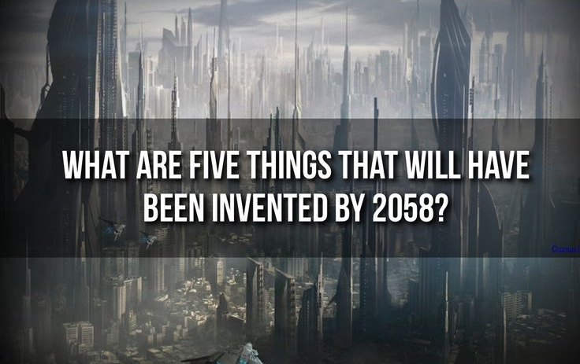
Monday, 6 May 2019
SWBAT…
Understand the importance and value of developing research skills.
WARM-UP
AGENDA
Intro Research Packet (RP)
Calendar
Self evaluation
Rubric
DUE DATES
Today: RP Complete Self-Evaluation (p. 2)
8May2019: Choose research topic (turn in RP)

Slide 3
RP Exit Ticket (P.6)
Instructions:
Name a controversial topic you may want to research.
What is your stance (opinion) on that topic?
What are your reasons for having that point of view?
ANSWER THE ABOVE IN 1 PAGE
(DUE BY THE END OF THE CLASS)

Slide 4
Tuesday, 7 May 2019
SWBAT…
Identify credible sources using the CRAAP Rubric.
WARM-UP
AGENDA
Selecting a research topic
Identify sources – intro CRAAP Rubric
DUE DATES
8May2019: Choose research topic (turn in RP)
NOTE: There are no more Centaur Plus sessions. If you need assistance, make an appt. with Mr. B

Slide 5
Tuesday, 7 May 2019 (P.6)
WRITE THE FOLLOWING…
Today, my goal is to choose a research topic, and identify credible sources using the CRAAP Rubric.
WARM-UP
AGENDA
Selecting a research topic
Identify sources – intro CRAAP Rubric
DUE DATES
8May2019: Choose research topic (turn in RP)
NOTE: There are no more Centaur Plus sessions. If you need assistance, make an appt. with Mr. B

Slide 6
The CRAAP Rubric
Take out your Research Packet
Read the 4 descriptions for each of the 5 categories of the CRAAP Rubric.
Underline the key words in each of the descriptions.
Write 1 question for each category about how you should use the CRAAP Rubric in your research (P.5/6)

Slide 7
Wednesday, 8 May 2019
SWBAT…
Evaluate credible sources using the CRAAP Rubric.
WARM-UP
AGENDA
Practice CRAAP analysis
Choose research topic and write research question
DUE DATES
Today: Choose research topic (pgs. 1-5 completed)

Slide 8
Wednesday, 8 May 2019 (P.6)
WRITE THE FOLLOWING…
Today, my goal is to accurately evaluate credible sources using the CRAAP Rubric, and choose a research topic.
WARM-UP
AGENDA
Practice CRAAP analysis
Choose research topic and write research question
DUE DATES
Today: Choose research topic (pgs. 1-5 completed)

Slide 9
Evaluate Sources Using CRAAP Rubric
Instructions:
Score each the following stories using the CRAAP Rubric
Write your answers on page 5 of your RP.

Slide 10
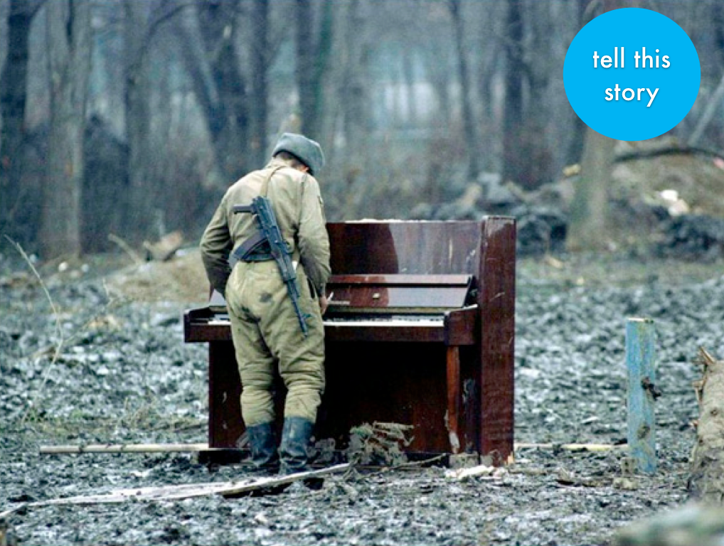
Thursday, 9 May 2019
SWBAT…
Correctly quote and paraphrase research sources in MLA format.
WARM-UP
AGENDA
Search Terms (P.3)
Optional research sources (P.6)
Quote vs. Paraphrasing (P.7)
Intro Research Log
DUE DATES
TBD

Slide 11
Thursday, 9 May 2019 (P.6)
WRITE THE FOLLOWING…
Today, my goal is to correctly quote and paraphrase research sources in MLA format.
WARM-UP
AGENDA
Search Terms (P.3)
Optional research sources (P.6)
Quote vs. Paraphrasing (P.7)
Intro Research Log
DUE DATES
TBD

Slide 12
Friday, 10 May 2019
SWBAT…
Construct a preliminary Research Log
WARM-UP
AGENDA
Complete preliminary Research Log
DUE DATES
TBD

