Slide 1
The Cold War Game
How did the West establish its dominance in the Cold War from the very beginning?

Slide 2
WWII: The Fight For Germany
USA
USSR
Atlanticists
Eurasianists
WEST
GERMANY
EAST
NATO
Warsaw Pact
Sea Power
Land Power
Notes:
West Germany joined NATO in 1955, which led to the formation of the rival Warsaw Pact during the Cold War.

Slide 3
The Bipolar Balance of Power: The Geopolitics of Proxy Wars
The Cold War was often fought (whenever it became a hot war) by proxies, or representatives of the US and the USSR in the Third World. Major exceptions include Korea and Vietnam, where US troops were involved.

Slide 4
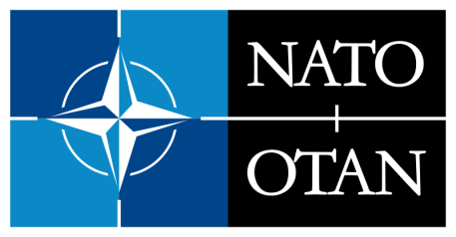
North Atlantic Treaty Organization
(1949-Present)
Military alliance – members agree to mutual defense in response to an attack by any external party (Article 5) "to keep the Russians out, the Americans in, and the Germans down*"
NATO Stay Behind Armies-prevent an attempted Soviet takeover of Europe
Operation Gladio (26Nov1956 – 27Jul1990)
Secret armies committed acts of terrorism and blamed it on the Soviets (communists)
Goal was to create a “strategy of tension”
“In silence, we serve freedom.”
*NATO’s first secretary general, Hastings “Pug” Ismay, when speaking about the new organization’s mission
Notes:
https://www.washingtonexaminer.com/weekly-standard/what-is-the-purpose-of-nato-keep-the-russians-out-the-americans-in-and-the-germans-down

Slide 5
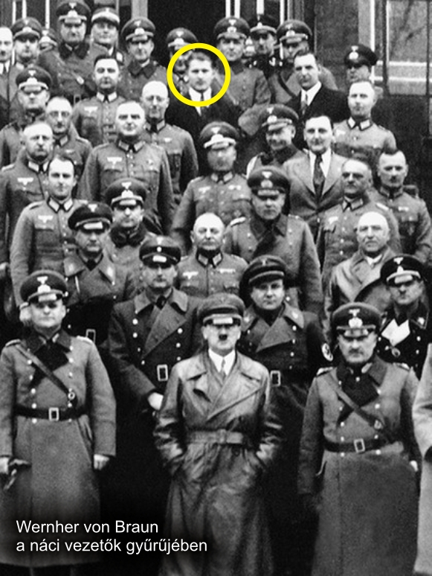
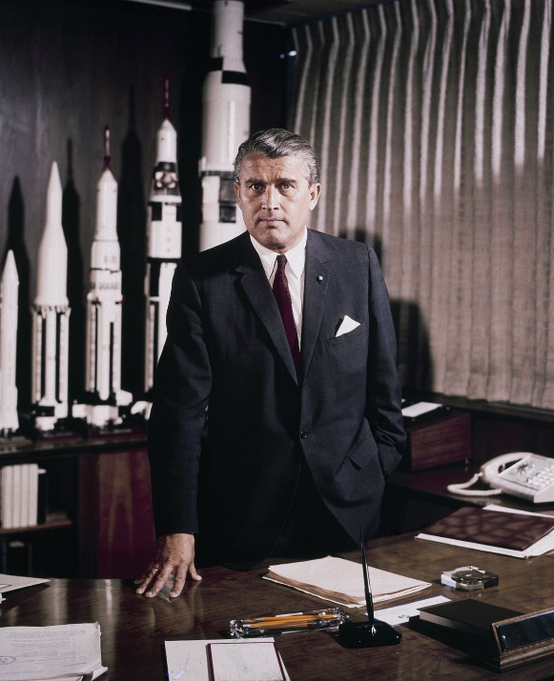
*Operation Paperclip
(1945-59)
Secret US Intelligence program that recruited more than 1,600 scientists, engineers, and technicians from Nazi Germany after World War II.
Purpose was for the US to gain a military advantage in the Cold War against the Soviet Union.
Above and Left: Nazi, Germany aerospace engineer Wernher von Braun (key developer of the V-2 rocket); later head of NASA’s space program
*Operation Paperclip was previously called Operation Overcast and was approved by President Truman

Slide 6
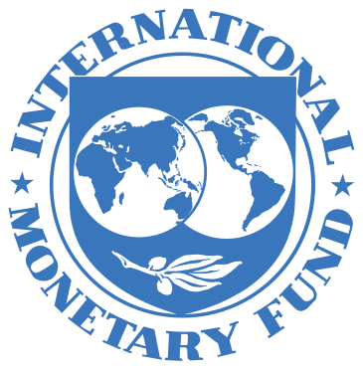
Bretton Woods Conference (1944)
Allied nations decided the new financial rules of the world
International Monetary Fund & World Bank (1945)
Promote international monetary cooperation, trade, high employment, economic growth
Prevent poverty, and provide loans to countries in financial difficulty

Slide 7
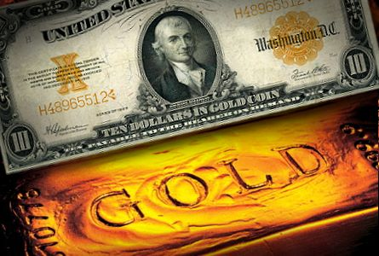
Bretton Woods Conference (1944)
Promote international monetary cooperation
US Dollar-Gold Exchange
World Reserve Currency
Lender of last resort
All transactions would be completed using US Dollars

Slide 8
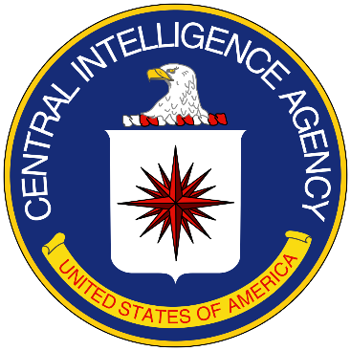
National Security Act (1947)
Key legislation in Truman’s Cold War strategy, and the beginnings of the National Security State (aka, The Deep State).
Restructured the armed forces by creating the National Military Establishment (later called the Dept. of Defense), the CIA, and the National Security Council.
Helped to prevent another Great Depression by creating a permanent wartime economy (aka military industrial complex).

Slide 9
Us vs. Them? Origins of Soviet Power
US manufacturing and finance supported the creation of the Soviet Union by providing industrial and military technology, starting from the Bolshevik Revolution in 1917, to the collapse of the USSR in 1991.
US military aid to the Soviets continued while the Soviets were providing military aid to Vietnam during the Vietnam War.
Notes:
YOUTUBE LINK: https://www.youtube.com/watch?v=j3vZNSAi-QM
VIBBY LINK: https://vib.by/v/QJZrtflpoc
Clips:
00:00 to 03:15
20:13 to 24:43

Slide 10
How did the Western world establish its PESC dominance at the close of WWII?
Using your Star Chart answer the following:
How did the West establish political dominance?
How did the West establish economic dominance?
How did the West establish social dominance?
How did the West establish cultural dominance

