Slide 1
HISTORICAL ANALYSIS:
POWER AND IDEOLOGY
Beyond Good and Evil

Slide 2
HISTORICAL ANALYSIS:
POWER AND IDEOLOGY
“Not necessity, not desire - no, the love of power is the demon of men. Let them have everything - health, food, a place to live, entertainment - they are and remain unhappy and low-spirited: for the demon waits and waits and will be satisfied.”
~ Friedrich Nietzsche

Slide 3
AGENDA
What is Ideology?
The 4Cs of War
What is Power?
  Political & Economic Power
  Soft, Hard, and Smart Power
The 4Ds of War
Understanding history through the lens of Power and Ideology

Slide 4
IDEALOGY DEFINED
A set of conscious and unconscious ideas which make up one's goals, expectations, and motivations.
An ideology is a set of standards that is followed by people, governments, or other groups that is considered the "norm."
It can also be a set of ideas proposed by the dominant class of society to all members of society.
A system of thought applied to public matters, thus making this concept central to politics.
“The ultimate end of any ideology is totalitarianism.” ~ Tom Robbins

Slide 5
THE IDEOLOGY OF WAR (4Cs)
Control
  to exercise restraint or direction over; dominate; command
Coercion
  force or the power to use force to obtain compliance, as by a government or police force
Crisis
  a condition of instability or danger, as in social, economic, political, or international affairs, leading to a decisive change
Consolidation
  to bring together separate parts into a single or unified whole; unite; combine

Slide 6
UNDERSTANDING HISTORY THROUGH AN IDEOLOGICAL LENS
Good vs. Evil
Us vs. Them
Country vs. Country
West vs. East
Left vs. Right
Democrat vs. Republican
Liberal vs. Conservative
Liberalism vs. Realism
Doves vs. Hawks*
HORIZONTAL AXIS

Slide 7
IDEOLOGY: WHO STARTS WARS?
*Note: When military engagements begin during one administration and carry over into another, they are counted once for each administration.
Sources: https://en.wikipedia.org/wiki/Timeline_of_United_States_military_operations; https://en.wikipedia.org/wiki/List_of_Presidents_of_the_United_States

Slide 8
POWER DEFINED
Power is the ability to influence, direct, or create the actions and outcomes of individuals, groups, and events by political or economic means.
“Power tends to corrupt and absolute power corrupts absolutely.” ~ Lord Acton

Slide 9
POLITICAL & ECONOMIC POWER
Political Power is the ability to control scarcity (resources that are in limited supply – manufactured or actual).
Economic Power is the ability to create scarcity.
Economic Power is used for the purpose of expanding or strengthening Political Power.
“Nearly all men can stand adversity, but if you want to test a man's character, give him power.” ~ Abraham Lincoln

Slide 10
SOFT, HARD, and SMART POWER
Soft Power is the shaping of preferences of States through attraction and co-opting by appealing to culture, political values, and diplomacy and economic incentives to influence States (rewards, incentives, aka Carrot).
Hard Power is the coercive or aggressive use of military and economic means to influence the behavior or interests of States (punish, disincentives, aka Stick).
Smart Power is the use of a combination of Hard and Soft Power
“Power concedes nothing without a demand. It never did and it never will.” ~ Frederick Douglass

Slide 11
WAR AS AN EXERCISE OF POWER
War is the most extreme expression of Political and Economic Power.
War is the primary driver of history, as it shapes our world in ways that nothing else can.
War is unlike any other historical phenomenon as it has the ability to create the 4Ds on a massive scale.
“Political power grows out of the barrel of a gun.” ~ Mao Zedong

Slide 12
THE POWER OF WAR (4Ds)
Death
  An example of the use of Hard Power
  Reduces population
Disease
  An example of the use of Hard Power
  Increases need for medical resources
Displacement/Destabilization
  An example of the use of Soft Power
  Increases emigration to other regions (refugees)
Debt
  An example of the use of Soft Power
  Increases control of means and modes of production

Slide 13
THE EFFECTS OF WAR (4Ds)
Death
  Civilian casualties (“collateral damage,” aka children)
  Soldier casualties (by enemy forces, and “friendly fire”)
  New weapons testing
Disease
  Drug trafficking
  Environmental destruction
  Starvation, Cancer, PTSD
Displacement/Destabilization
  Human trafficking/Slavery (women, children, etc.)
  Organ Harvesting
  Prostitution, Rape
Debt
  Rebuilding contracts given to private corporations
  Currency devaluation/collapse
  IMF/World Bank loans to stabilize economy

Slide 14
UNDERSTANDING HISTORY THROUGH THE LENS OF POWER
VERTICAL AXIS
Freedom vs. Tyranny
Democracy vs. Plutocracy/Oligarchy
Decentralization vs. Centralization
Individualism vs. Collectivism
Creditors vs. Debtors
“Experience hath shewn, that even under the best forms of government those entrusted with power have, in time, and by slow operations, perverted it into tyranny.” ~ Thomas Jefferson

Slide 15
POWER: WHO SUPPORTS WAR?
Source: http://www.lowvarates.com/va-loan-blog/military-spending-republicans-vs-democrats/

Slide 16
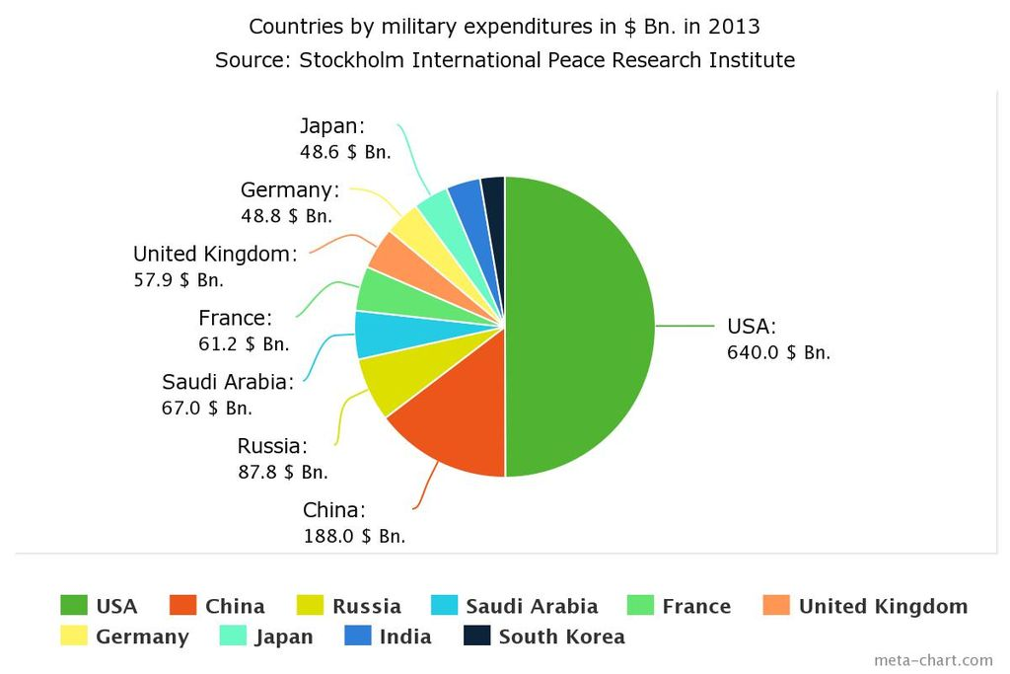
THE GROWTH OF HARD POWER
Source: https://en.wikipedia.org/wiki/Military_budget_of_the_United_States#/media/File:Top_ten_military_expenditures_in_$_in_2013.jpg

Slide 17
AXIS OF POWER AND IDEOLOGY
Tyranny
Centralization
POWER
Them
Us
HORIZONTAL AXIS
IDEOLOGY
VERTICAL AXIS
Good
Evil
Decentralization
Freedom

Slide 18
CONDUCTING HISTORICAL ANALYSIS
When looking at an historical event, keep in mind that there are 2 basic ways to interpret the data:
  Through the lens of Ideology
  Through the lens of Power
It is important to examine both Ideology and Power, because each is limited in their ability to explain the entire picture.

Slide 19
POWER AND IDEOLOGY
“He who fights with monsters should look to it that he himself does not become a monster. And when you gaze long into an abyss the abyss also gazes into you.”
Beyond Good and Evil, Aphorism 146 (1886)
~ Friedrich Nietzsche

