Slide 2
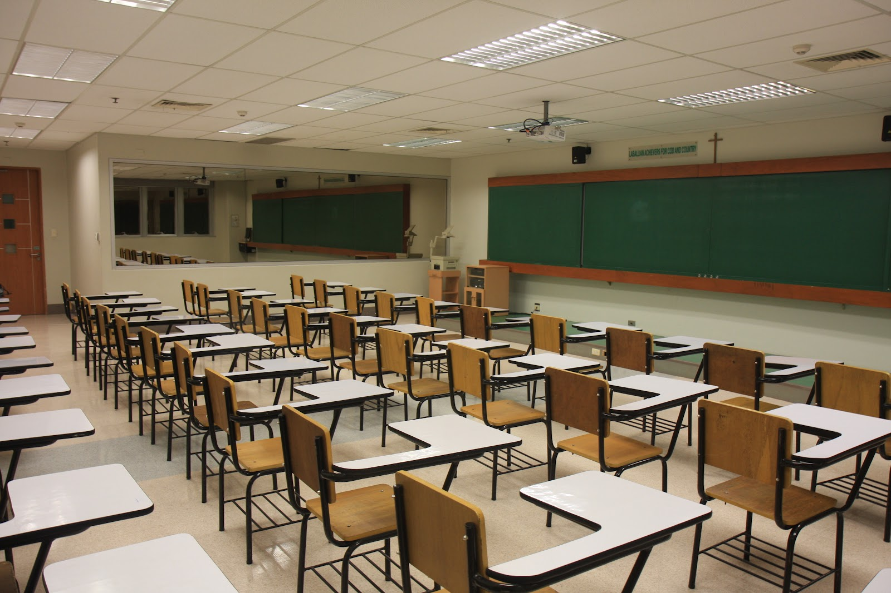
New Seating Chart
Please gather your things and listen for your name. You will be assigned a new seat.

Slide 3
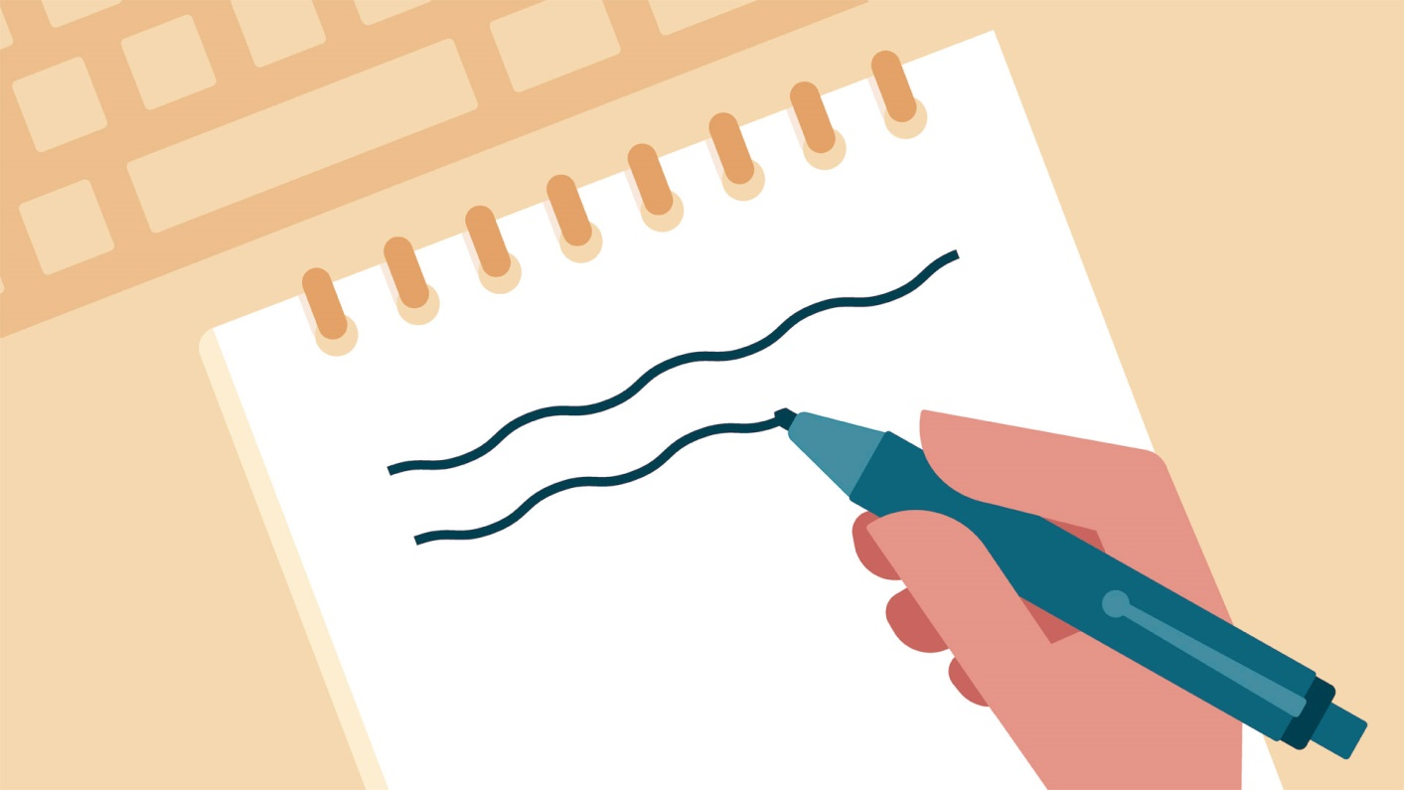
Prepare To Take Notes Now
Please take out your notebook and pen/pencil and prepare to copy the information on the next few slides in your own words.

Slide 4
How to organize your Notebook
You will make entries in your Notebook each day.
Place your paper clip on the page of the most recent entry in your Notebook
Notebook checks happen weekly (during silent reading time), and are graded for completion

Slide 5
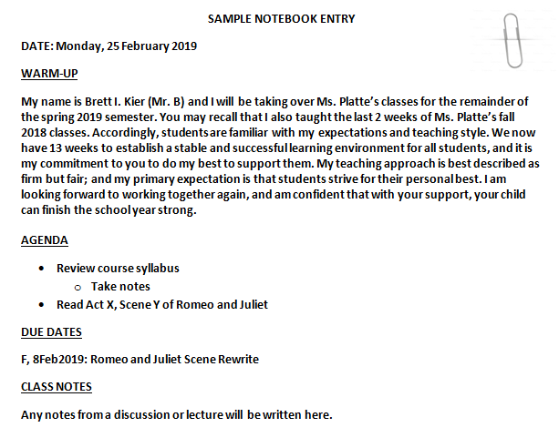

Slide 6
Monday, 25 February 2019
SWBAT…
Paraphrase, in writing, the new rules and expectations of the class.
DO NOW
Take out your notebook and a pencil and quietly wait for the sound of the bell (place your syllabus and paperclip on your desk).
WARM-UP
Who is the most important person in your life? Why? (5 sent.)
AGENDA
Introductions, Seating chart
Take notes on class syllabus
Review class expectations and website
Preview remainder of semester
Notebook Check
DUE DATES:
M, 25Feb2019: Notebook Check
T, 26Feb2019: Signed Syllabus
=

Slide 7
Course Syllabus and Class Expectations
Bathroom breaks 15 min. after the bell; and up until 15 min. before the end of class.
No food, electronics, hats/hoods, or sunglasses in class (water is ok).
All work turned in must have Name, Date, and Period in upper left corner (if not, work will receive a 5% penalty).
Class Participation: points are earned when you participate in discussion.

Slide 8
Course Syllabus and Class Expectations
When you hear the bell, listen carefully.
Everything in, on, or around Mr. B’s desks is never to be touched without permission.
Centaur Plus will be your best opportunity to get one-on-one feedback from me about any assignments.
The agenda slides will be posted on the class website within 48 hours of the class.

Slide 9
Course Syllabus and Class Expectations
The materials you need for the day will be on the trapezoidal table.
The agenda slides will be posted on the class website within 48 hours of the class.
Stay in your seat/keep working until the bell rings.
Mr. B, not the bell, will dismiss you when you are sitting quietly in your seat.

Slide 10
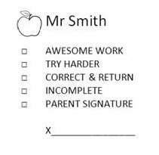
What does that stamp mean?
Follow the directions next to the check mark
Good Job!
Good Job!
Work turned in with no Name, Date, or Period (5% Penalty)
Worked turned in 1 day late (20% Penalty)
Worked turned in 1 day late after an excused absence (Full Credit)

Slide 11
Tuesday, 26 February 2019
SWBAT…
Create a storyboard that presents an alternative ending to Romeo and Juliet based on their understanding of Act 5, Scene 3 (lines 238-278).
DO NOW
Take out your notebook, copy the agenda, then put your Name, Date, and Period on the white printer paper. Title this blank paper “Romeo and Juliet 4 Panel Storyboard”
Take the book from under your desk and turn to page 1100.
WARM-UP
Describe a decision you made that if you could do over you would do differently? (5 sent.)
AGENDA
R&J: Read lines 238-78 of A.5, S.3
Begin 4 Panel Storyboard
DUE DATES:
> Today: Signed Syllabus
> W, 27Feb2019: R&J 4 Panel Storyboard

Slide 12
R & J: 4 Panel Storyboard
Requirements:
3 sentences of narration per panel (3rd person)
Dialogue in each panel
Color illustrations for each panel

Slide 13
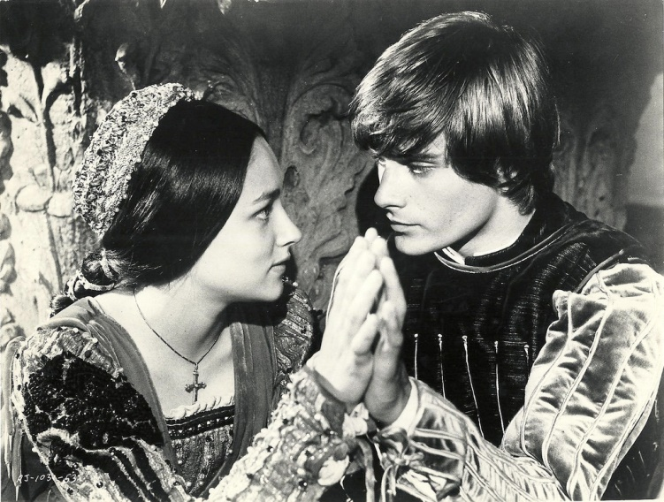
Wednesday, 27 February 2019
SWBAT…
Complete a storyboard that presents an alternative ending to Romeo and Juliet.
DO NOW
Copy the agenda and complete the Warm-Up.
WARM-UP
If you had to live your life as an animal, which one would you choose to represent your personality? Why? (5 sent.)
AGENDA
Complete your “Romeo and Juliet 4 Panel Storyboard”
DUE DATES:
> Today: R&J 4 Panel Storyboard

Slide 14
Thursday, 28 February 2019
SWBAT…
Read, annotate, identify textual evidence, and summarize text
DO NOW
Take out your notebook, complete the WARM-UP, and copy the AGENDA.
WARM-UP
1. All people are equal. TRUE/FALSE
2. Usually, the best and brightest people are leaders. TRUE/FALSE
3. Good citizens always follow the laws of their government. TRUE/FALSE
4. A dictator can be easily overthrown. TRUE/FALSE
5. The government usually does what is best for the most people. TRUE/FALSE
6. People should always believe what they’re told by authorities. TRUE/FALSE
7. Uneducated people are more easily controlled than educated people. TRUE/FALSE
8. People always have the ability to make their own choices. TRUE/FALSE
AGENDA
The Third Wave document analysis
DUE DATES
> F, 1Mar2019: Notebook Check

Slide 15
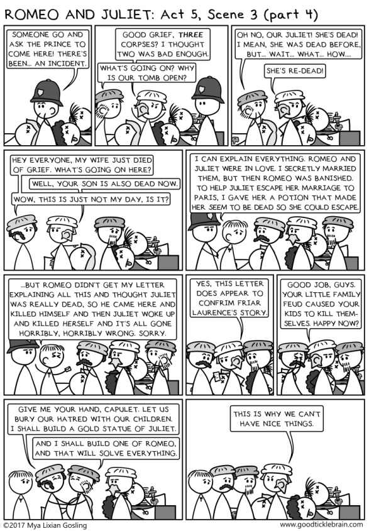
R & J Storyboard Rubric
POINTS PER PANEL
Dialogue – 1 point
Illustration – 1 point
Color – 1 point
Narration – 3 points (1 per sent.)
TOTAL POINTS PER PANEL: 6 Points
(6 points x 4 panels = 24 points)
Cool Factor – 1 point
TOTAL POINTS POSSIBLE: 24 + 1 = 25 points

Slide 16
Friday, 1 March 2019
SWBAT…
Summarize text using claims, reasons, evidence, and counter-claims/rebuttal.
WARM-UP
Copy the following sentences (skipping lines):
Esperanza should be elected class president because she is a natural leader. When we got lost in the Yosemite Mountains on our class trip, Esperanza took control and navigated us back to civilization. >>>
Although Talia is running for a second term, she has not kept her campaign promises.
AGENDA
Take notes: Claims, Reasons, Evidence, Counterclaims/Rebuttal
Complete The Third Wave document analysis
DUE DATES
Today: Notebook Check
M, 4Mar2019: The Third Wave doc analysis packet

Slide 17
Claims
A claim is your ARGUMENT. Claims are statements of belief that can be argued against.
Ex Gratia (e.g. – for example): Esperanza should be elected class president.

Slide 18
Reasons
A reason is your LOGICAL SUPPORT. Reasons are statements of logic that support your statement or belief, id est (i.e. – that is to say), your claim.
Ex Gratia (e.g. – for example): Esperanza should be elected class president because she is a natural leader.

Slide 19
Evidence
Evidence is your PROOF. Evidence comes from sources, fieldwork, and research.
Ex Gratia (e.g. – for example): Esperanza should be elected class president because she is a natural leader. When we got lost in the Yosemite Mountains on our class trip, Esperanza took control and navigated us back to civilization.

Slide 20
Counter-claim/Rebuttal
Counter-claim/Rebuttal describes other plausible claims with COUNTER EVIDENCE and reasoning.
Ex Gratia (e.g. – for example): Esperanza should be elected class president because she is a natural leader. When we got lost in the Yosemite Mountains on our class trip, Esperanza took control and navigated us back to civilization. Although Talia is running for a second term, she has not kept her campaign promises.

Slide 21
The Third Wave Doc Analysis
Question: Do you think an experiment like the one conducted at Cubberley High School would work at Culver City High School? Why or why not?
Answer: The Third Wave experiment could work at Culver City High School because , although it is 2019 and not 1967, teenagers today are not very different from those in the past, in terms of being influenced by peer pressure.

Slide 22
The Third Wave Doc Analysis
Question: Do you think an experiment like the one conducted at Cubberley High School would work at Culver City High School? Why or why not?
Answer: The Third Wave experiment could work (claim) at Culver City High School because, although it is 2019 and not 1967, teenagers today are not very different from those in the past, in terms of being influenced by peer pressure.

Slide 23
The Third Wave Doc Analysis
Question: Do you think an experiment like the one conducted at Cubberley High School would work at Culver City High School? Why or why not?
Answer: The Third Wave experiment could work (claim) at Culver City High School because (reason), although it is 2019 and not 1967, teenagers today are not very different from those in the past, in terms of being influenced by peer pressure.

Slide 24
The Third Wave Doc Analysis
Question: Do you think an experiment like the one conducted at Cubberley High School would work at Culver City High School? Why or why not?
Answer: The Third Wave experiment could work (claim) at Culver City High School because (reason), although (counter-claim) it is 2019 and not 1967, teenagers today are not very different from those in the past, in terms of being influenced by peer pressure.

Slide 25
The Third Wave Doc Analysis
Question: Do you think an experiment like the one conducted at Cubberley High School would work at Culver City High School? Why or why not?
Answer: The Third Wave experiment could work (claim) at Culver City High School because (reason), although (counter-claim) it is 2019 and not 1967, teenagers today are not very different from those in the past, in terms of being influenced by peer pressure (evidence).

Slide 26
The Third Wave Doc Analysis
Summarize how the third wave developed so quickly.
Discussion Questions: Write in complete sentences using claims, reasons, evidence, and counter-claims/rebuttals.
Answers must be in Third Person (he, she, it, they, them)

