Slide 1
AGENDA
Review: Imperialism and the European Scramble for Africa
The Suez Canal
Article: European Imperialism: Egypt and Control of the Suez Canal
Intro to the Four Worlds of History (4WH)
Essential Question:
How did the creation of the Suez Canal affect the 4WH?

Slide 2
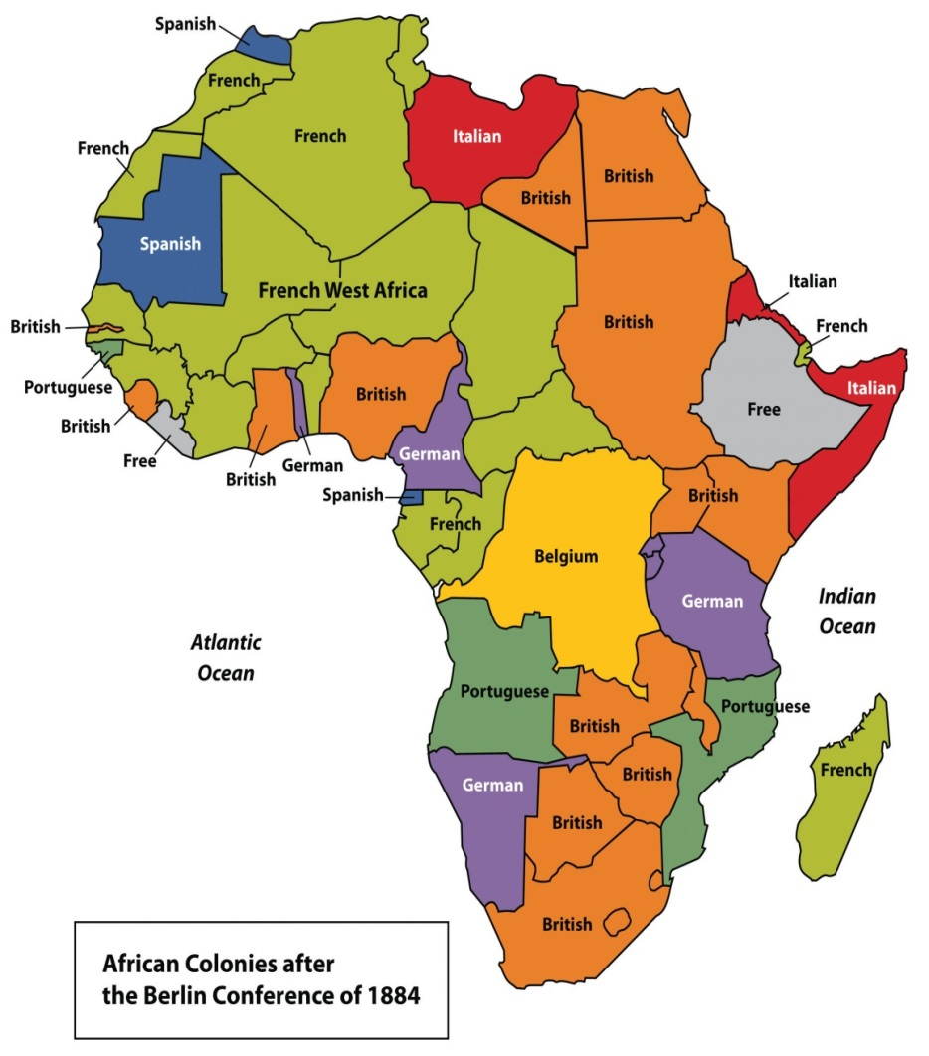
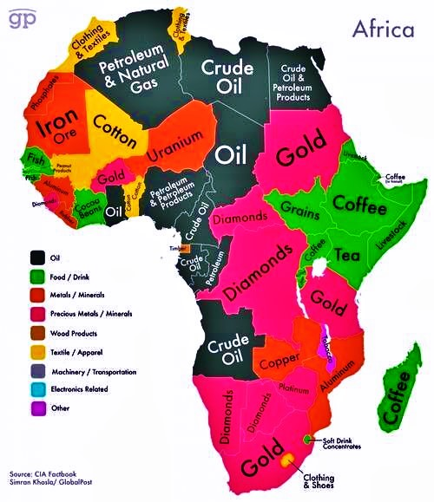
Scramble for Africa

Slide 3
EUROPEAN IMPERIALISM
Egypt and Control of the Suez Canal

Slide 4
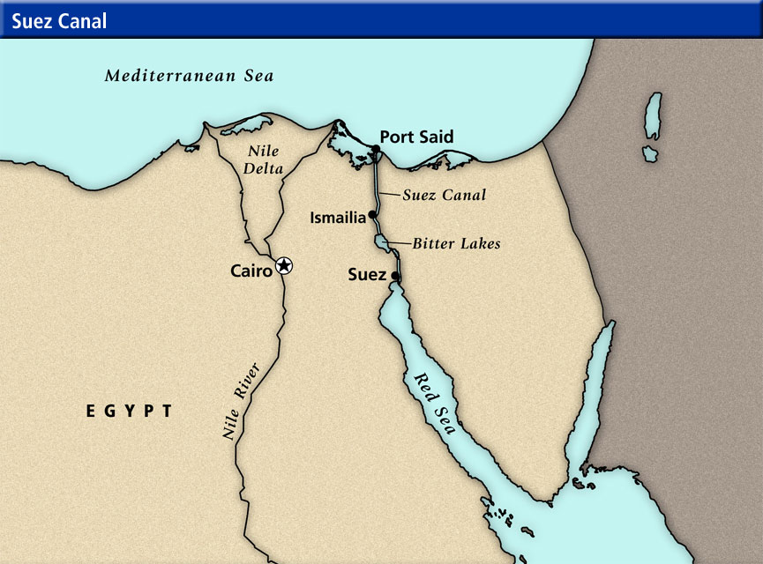

Slide 5
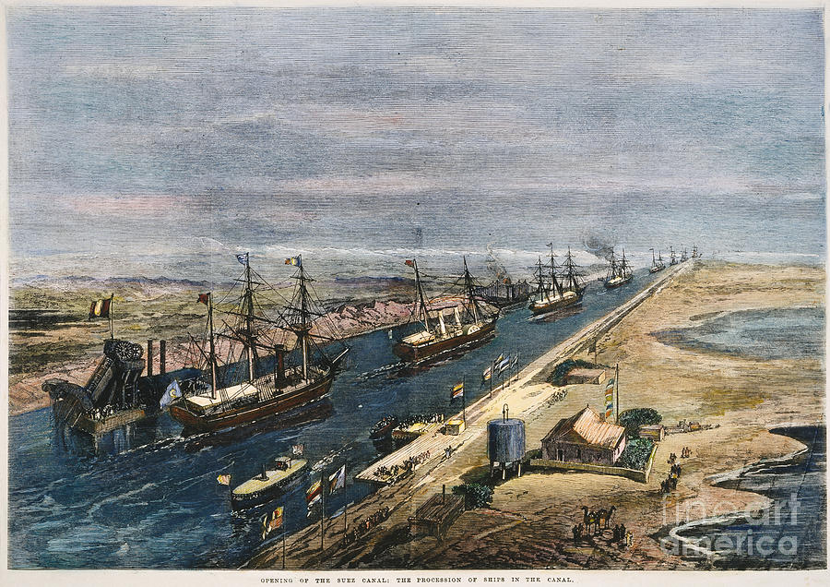
Early History (ca. 1869)

Slide 6
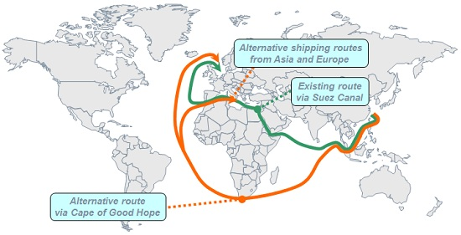
Trade Routes

Slide 7
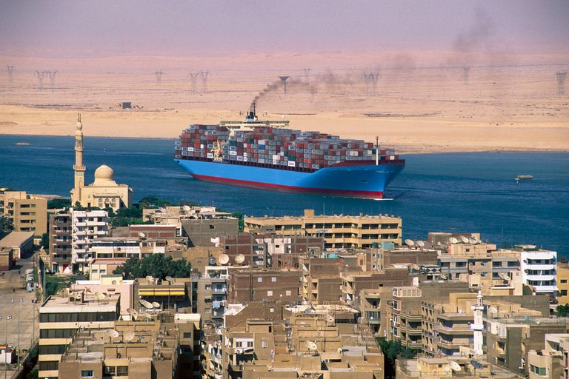
Commerce

Slide 8
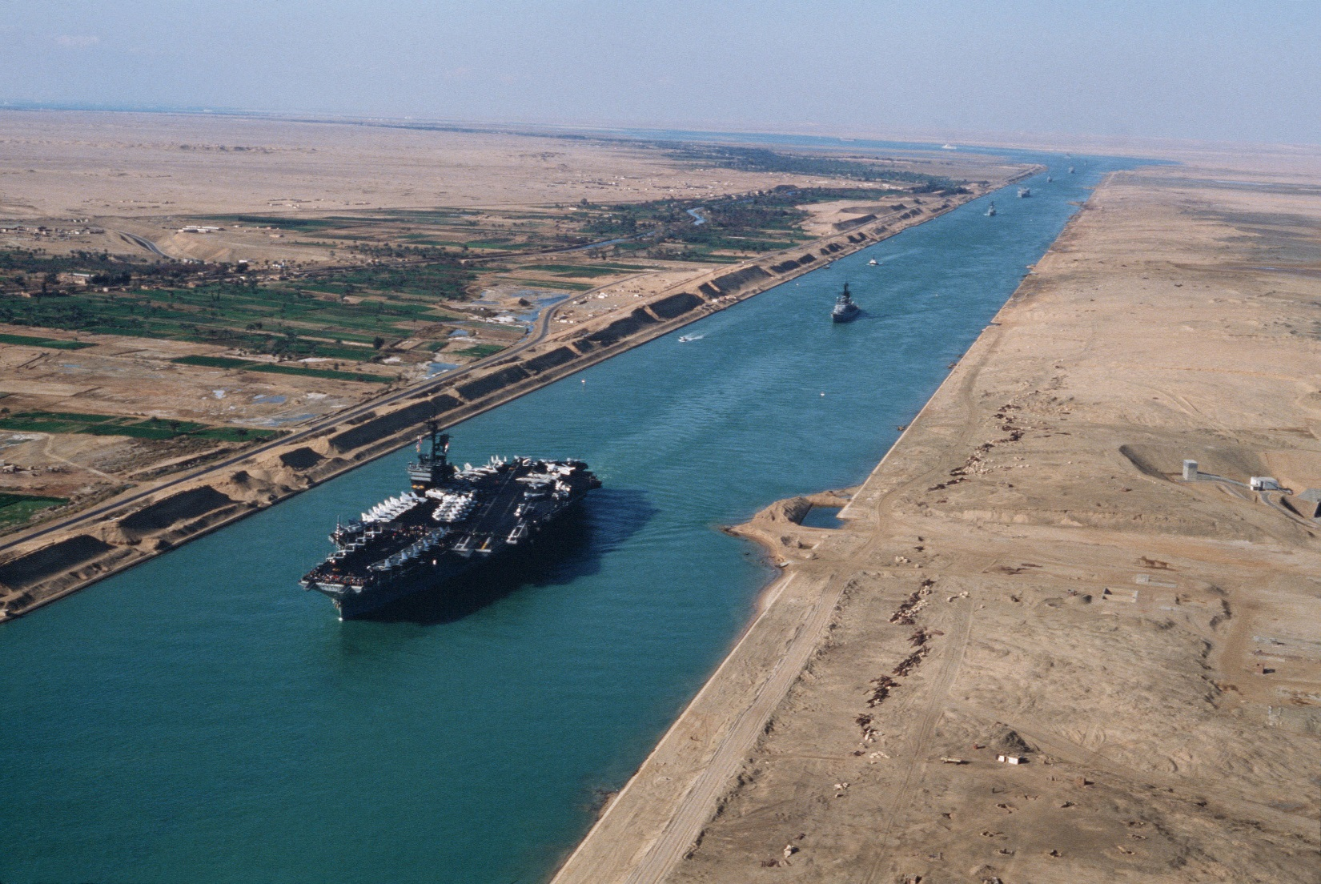
Military

Slide 9
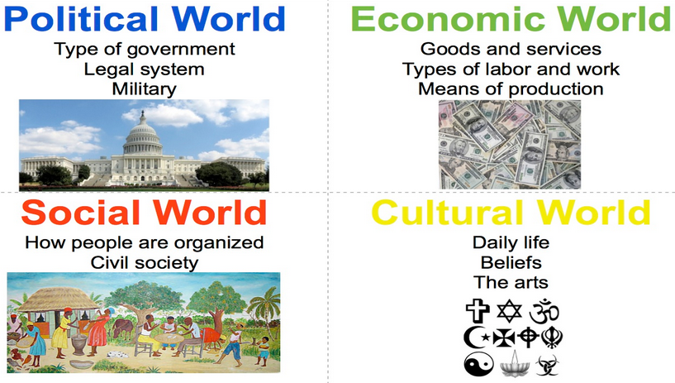
Four Worlds of History (4WH)

Slide 10
Essential Question
Textual evidence #1
Textual evidence #2
Textual evidence #3
How did the creation of the Suez Canal affect the 4WH?
Text example: "In the winter months, Marie walked to school each day uphill in the snow, just like her parents did when they were young.”
Inference: Marie wore warm clothes when walking to school.

